Slide 1
Shoes made of rumen
In the search of substitute materials during WW II
Silvie Lečíková
Museum of South-Eastern Moravia, Zlin
Czech Republic

Slide 2
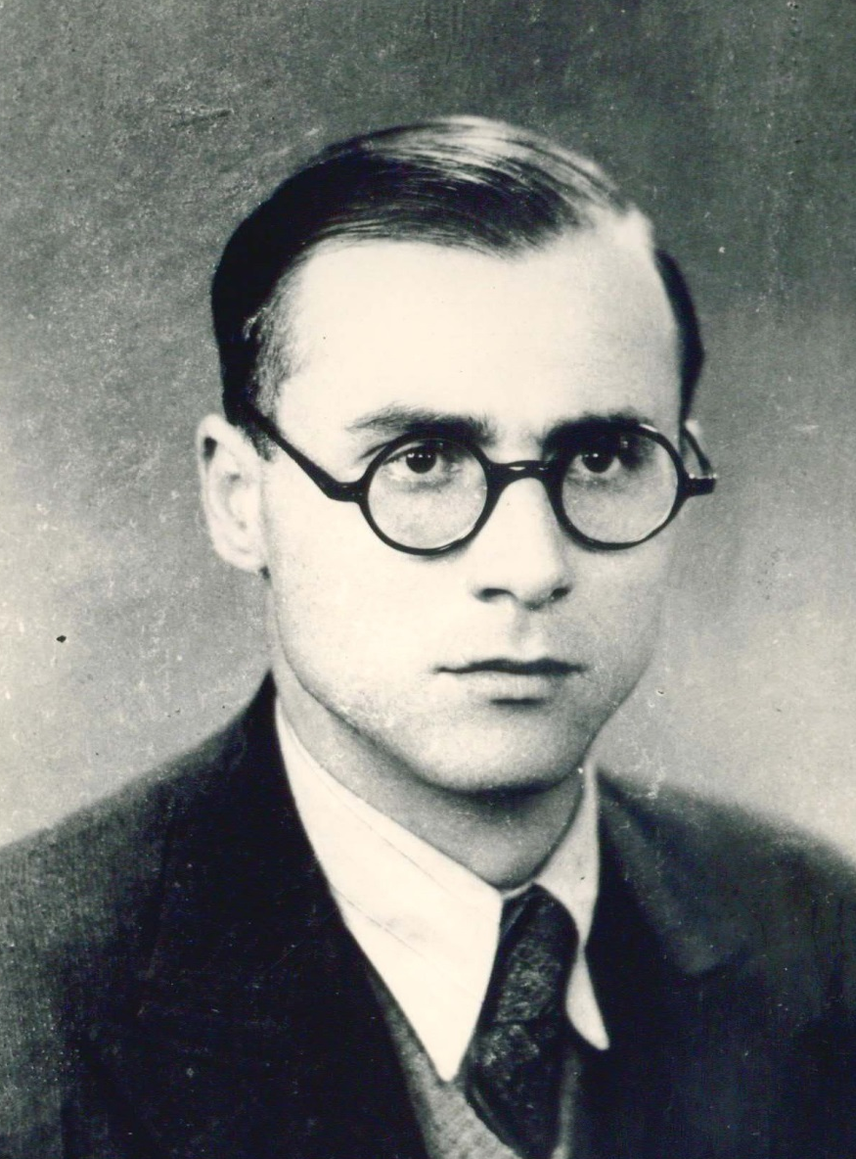
Doc. MVDr. RNDr. Jan HÖKL (1907 – 1951)
Photo: archives of VTU Brno

Slide 3
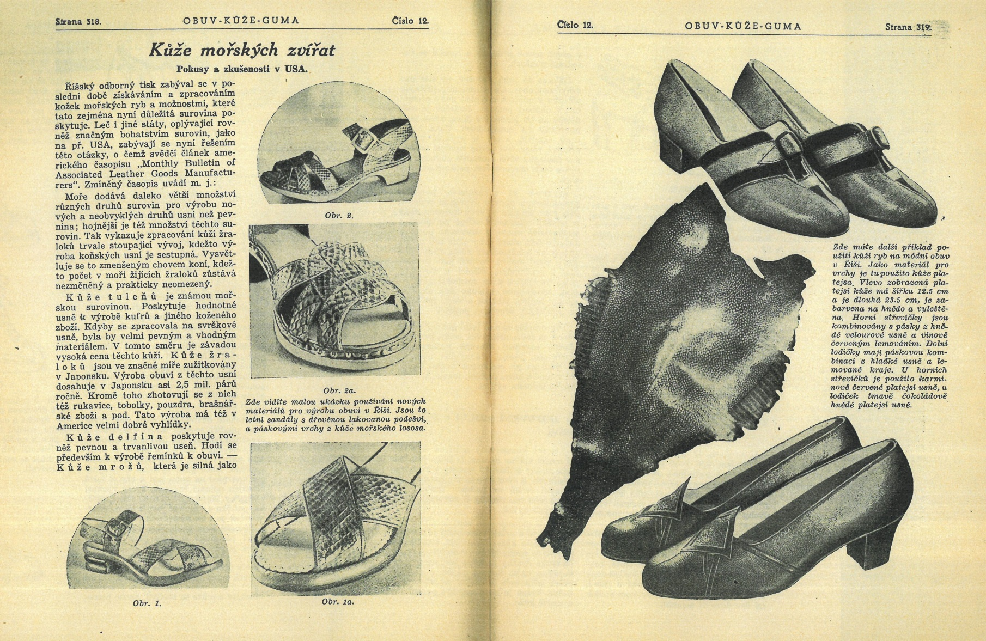

Slide 4
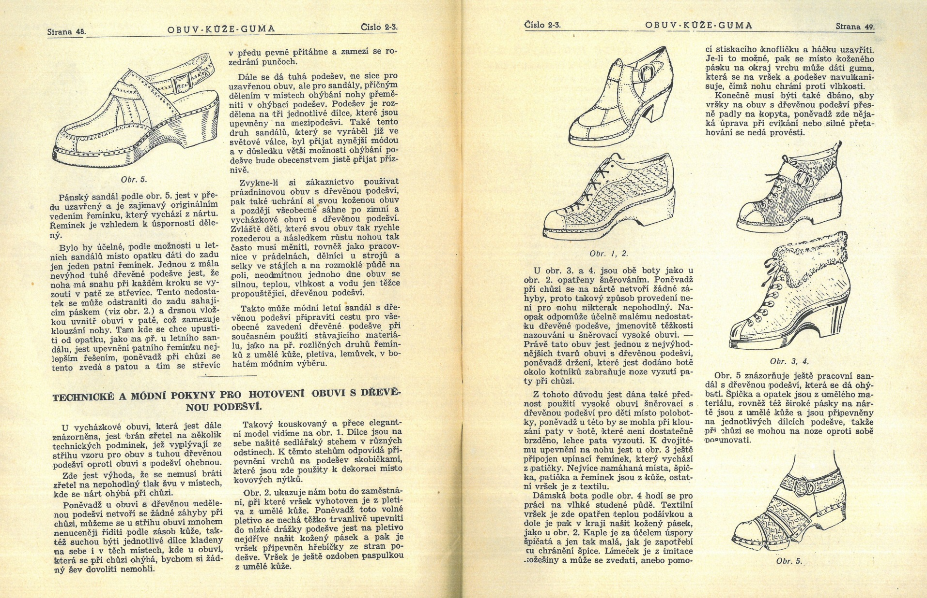

Slide 5
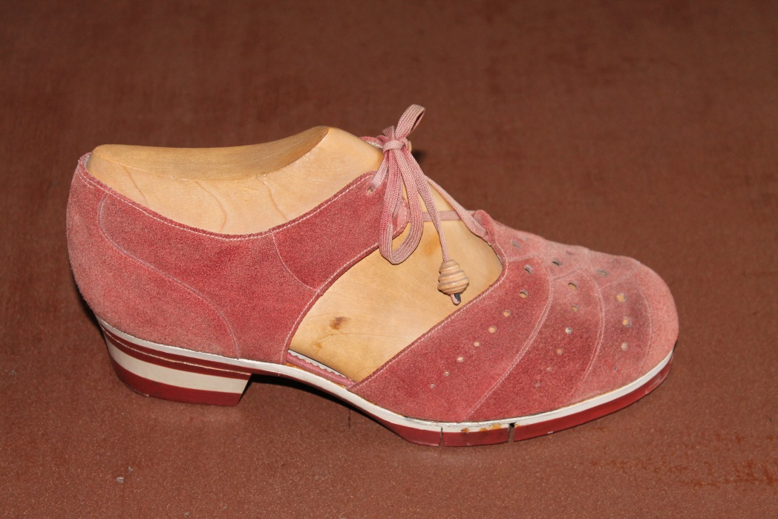
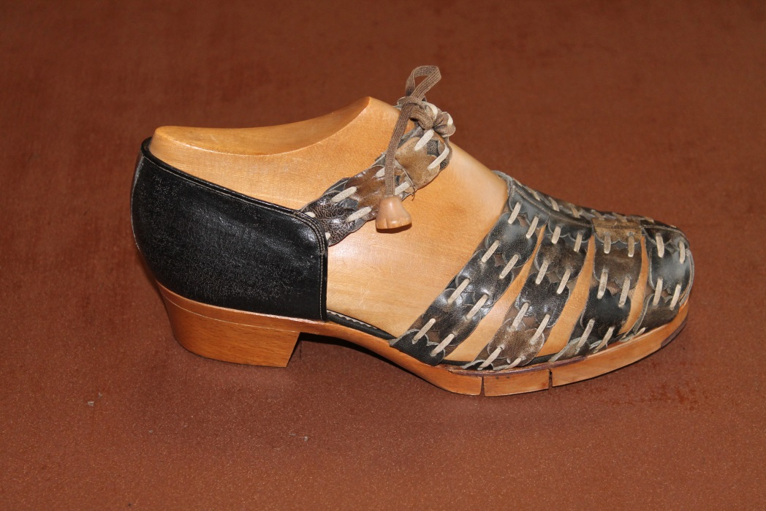
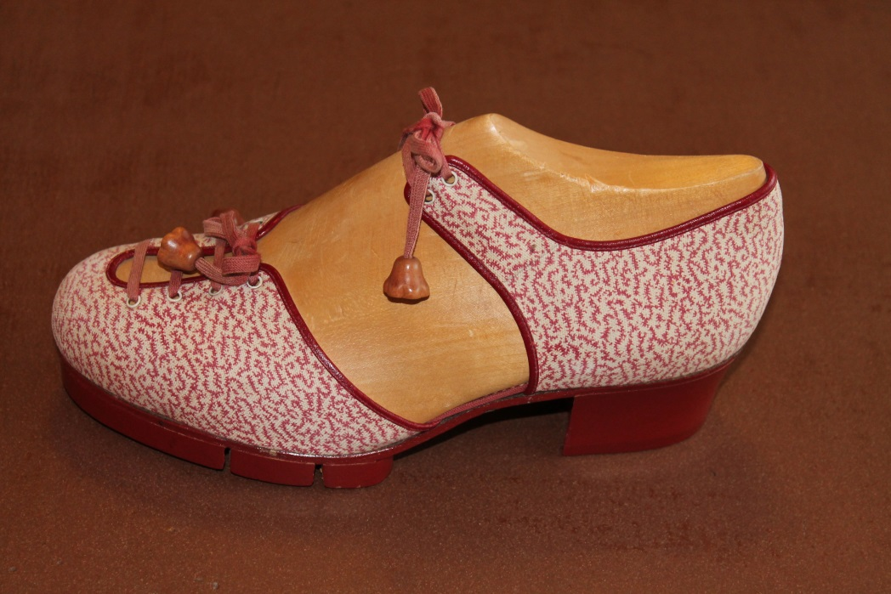
Clogs with wooden outsole, production of Bata Company,
1941 – 45,
collection of the Museum of South-Eastern Moravia, Zlin
Photo: archives of the Museum of South-Eastern Moravia, Zlin

Slide 6
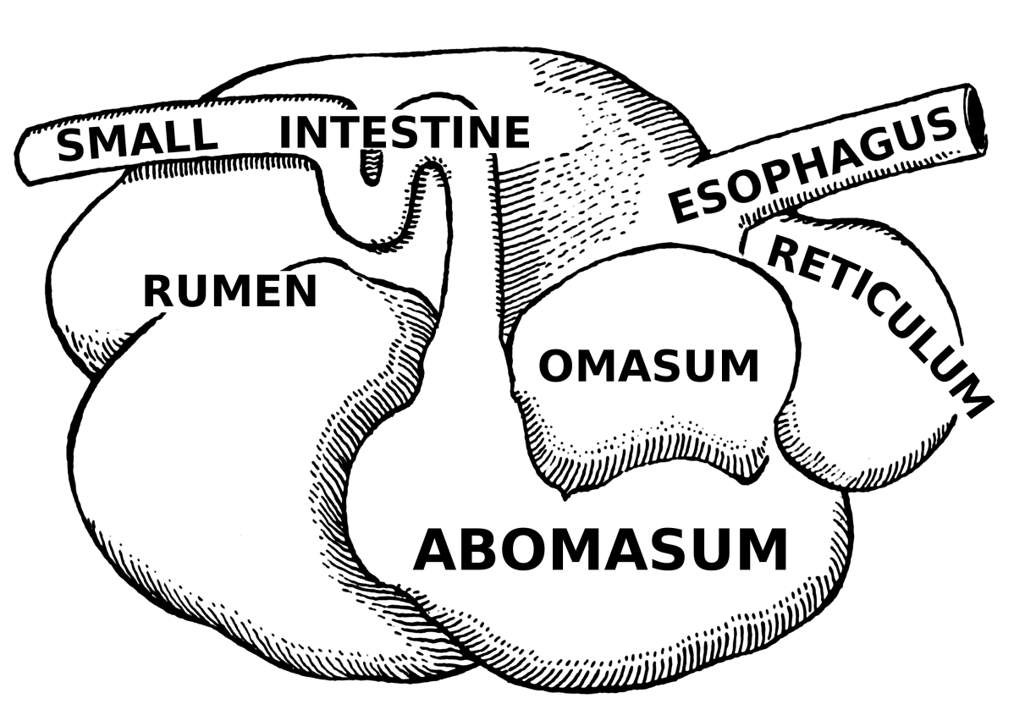
Bovine stomach (Wikipedia)

Slide 7
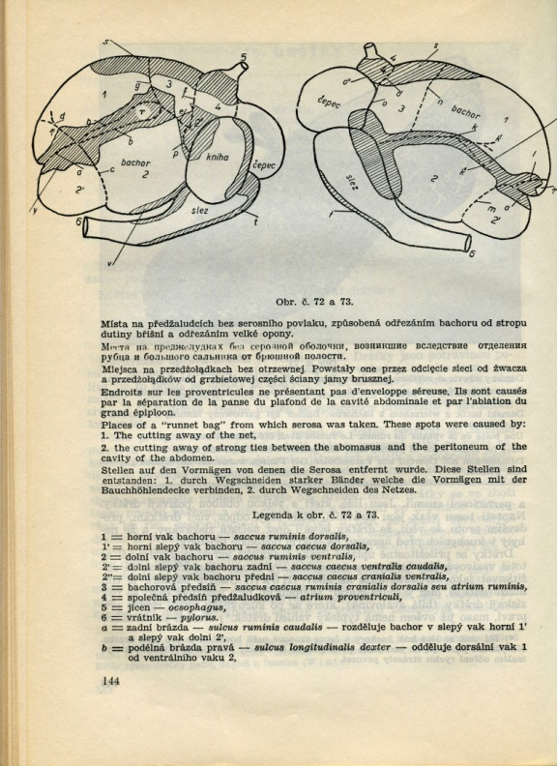
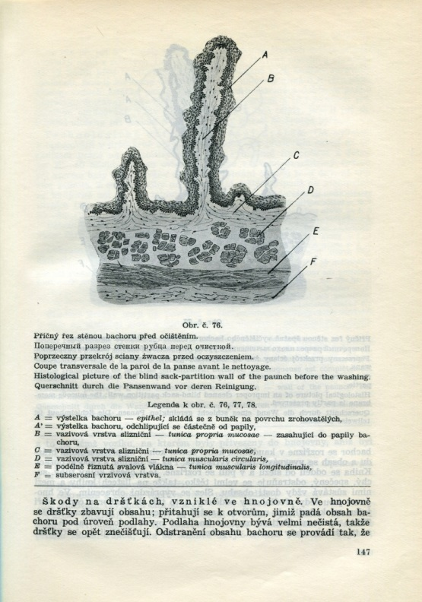
Veterinary Horizons, 32/1939, a part of article by dr. Hökl

Slide 8
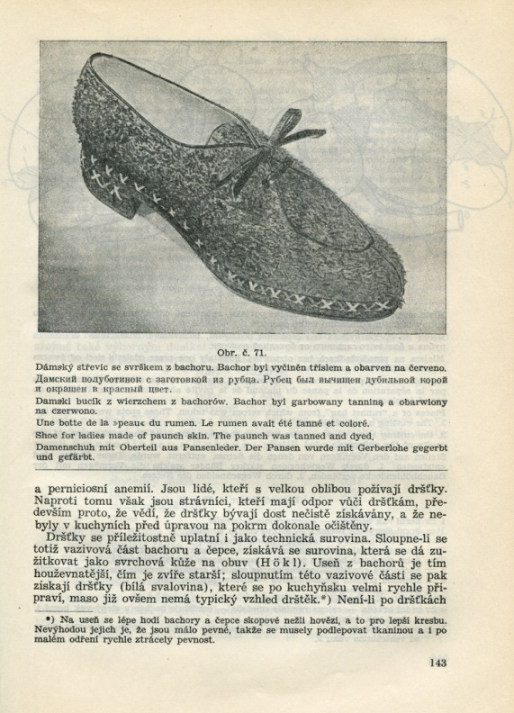
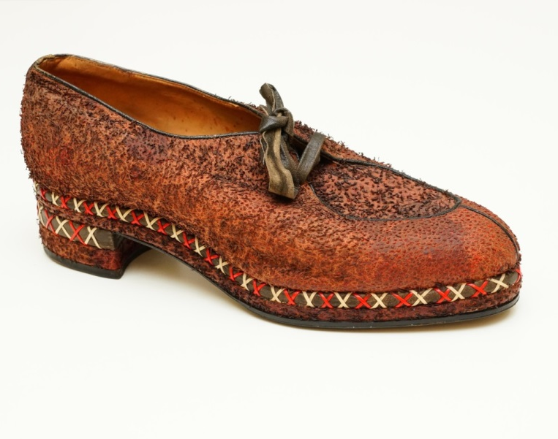
Photo: A. Kratky, VFU Brno

Slide 9
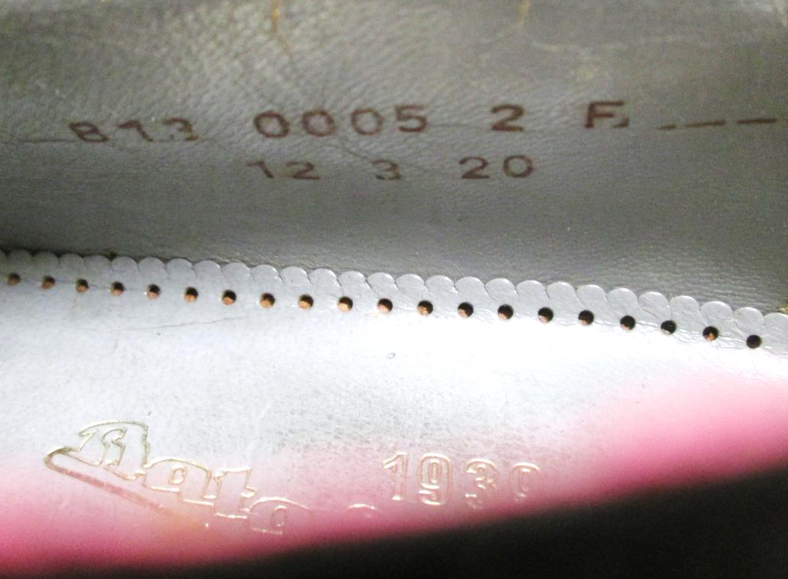
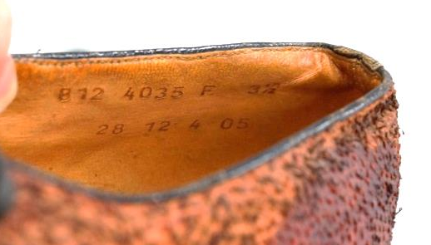

Slide 10
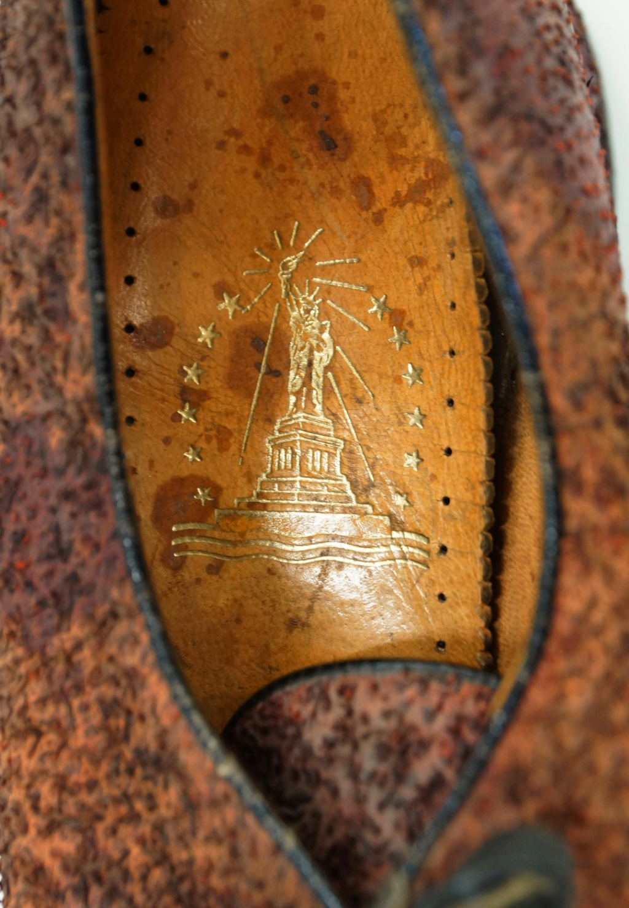
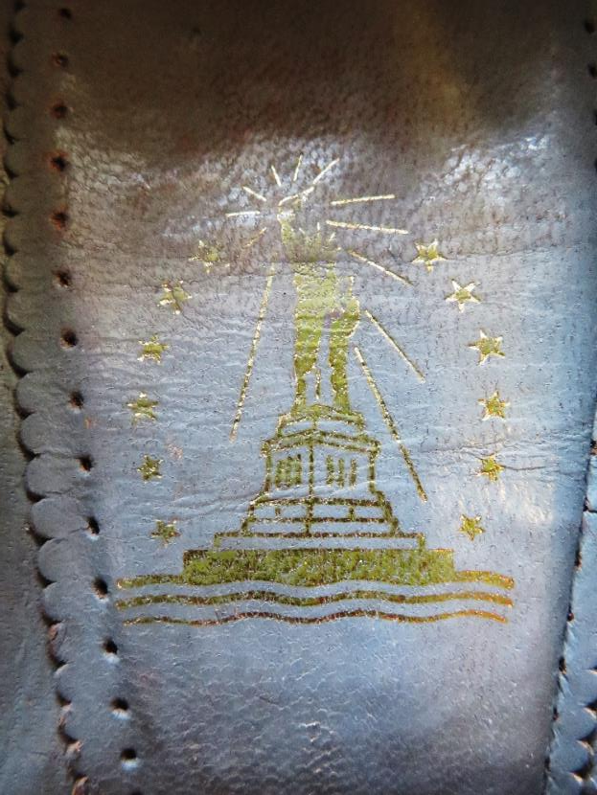
Photo: Horniser, Bruntal

Slide 11
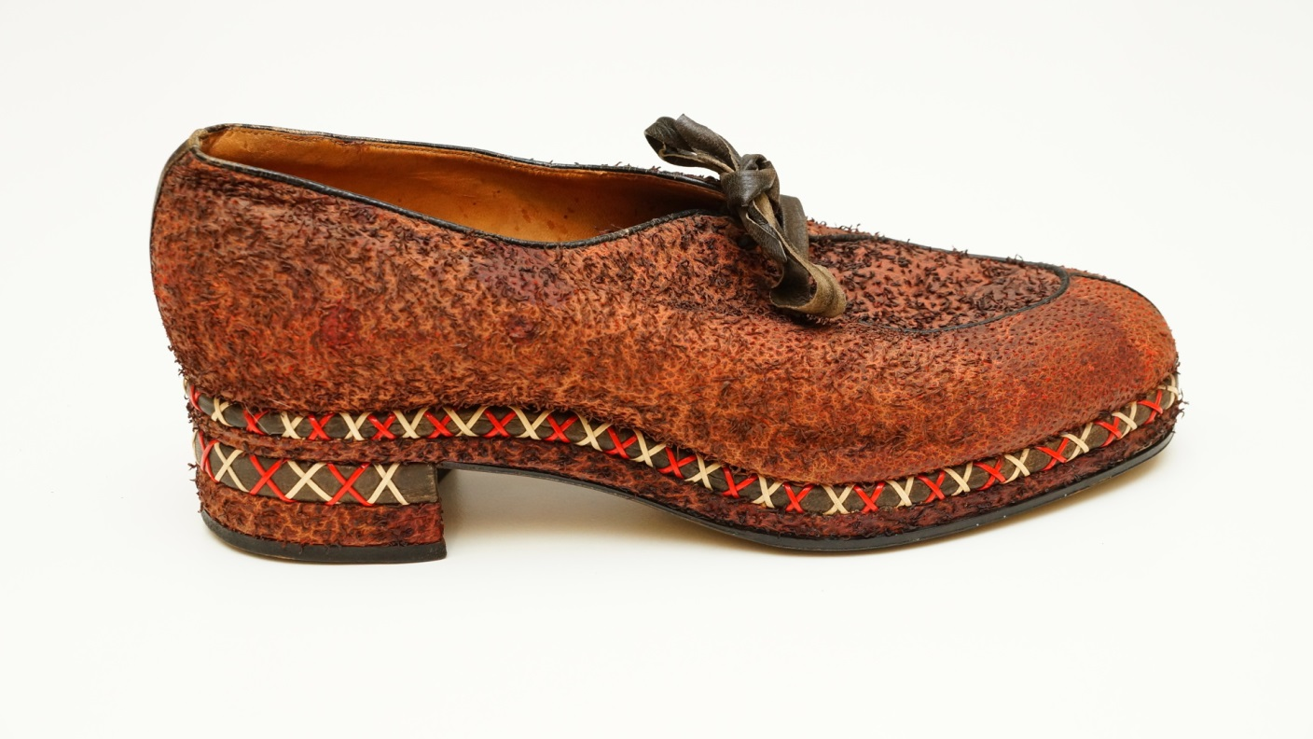
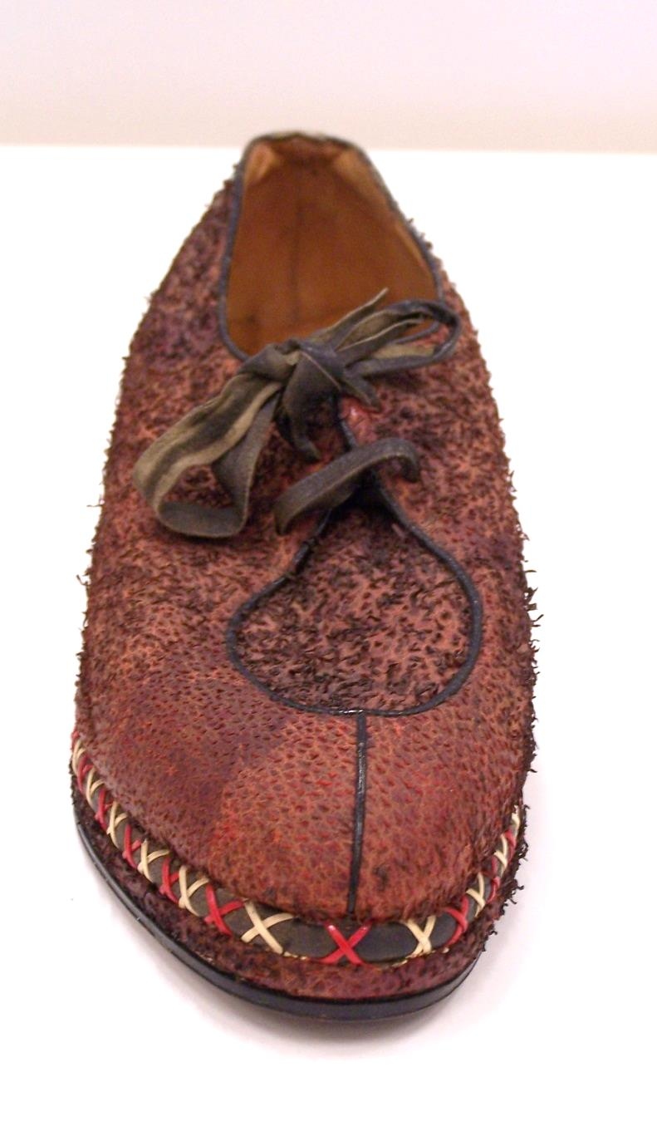
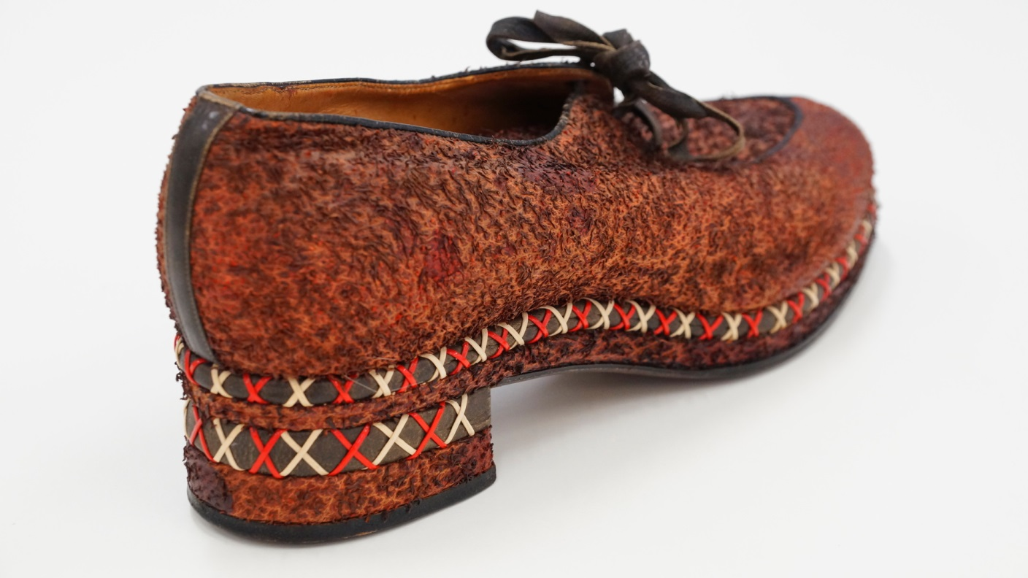
Photos: A. Kratky, VFU Brno

Slide 12
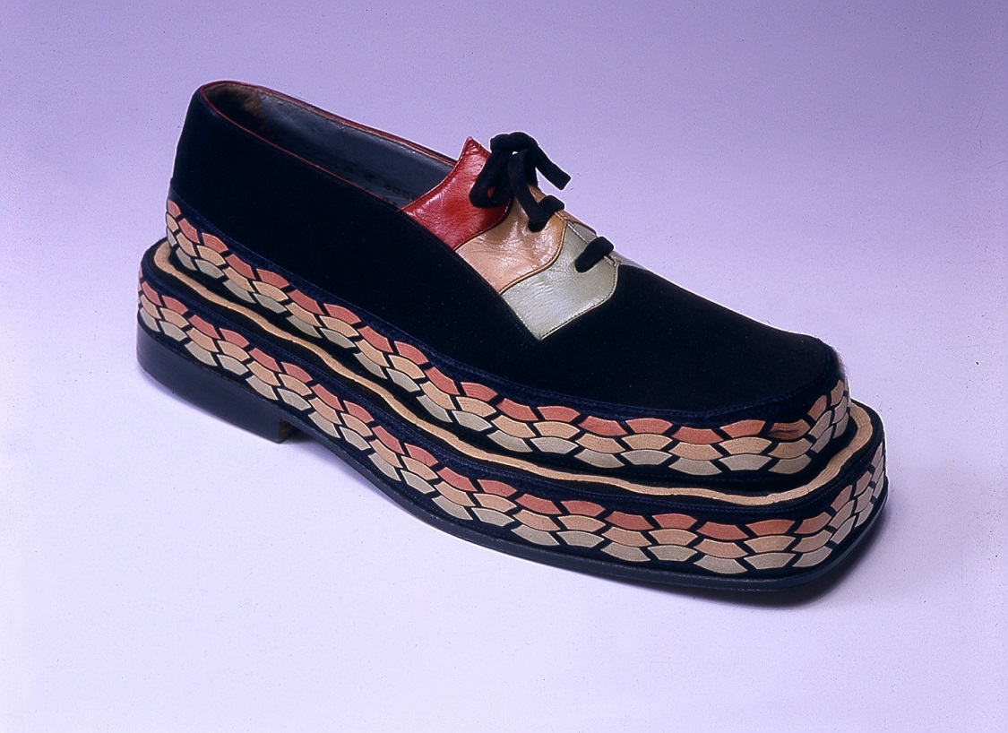
Women´s Oxford, 1939 Bata Company for the 1939 EXPO New York
Collection of the Museum of South-Eastern Moravia, Zlín
Photo: archives of the Museum of South-Eastern Moravia, Zlin

Slide 13
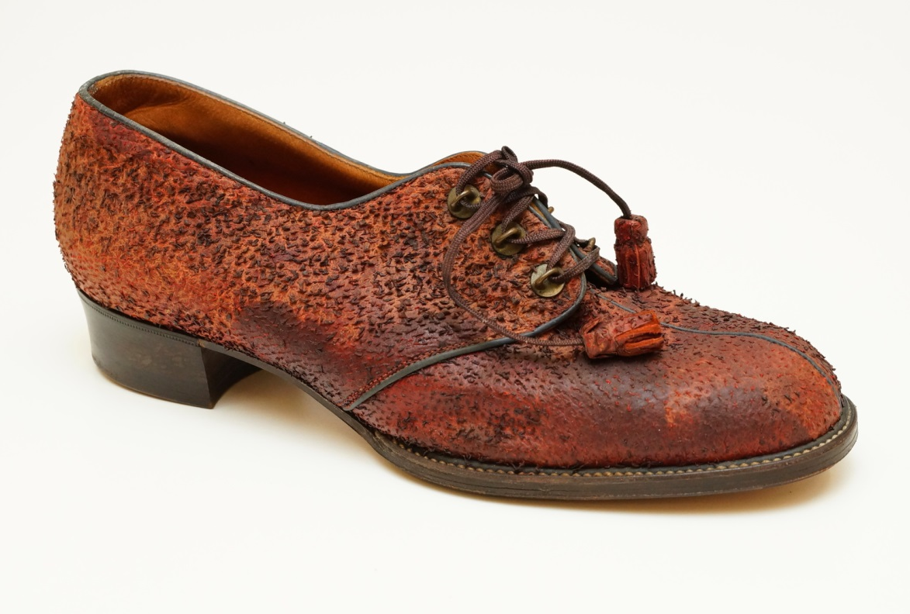
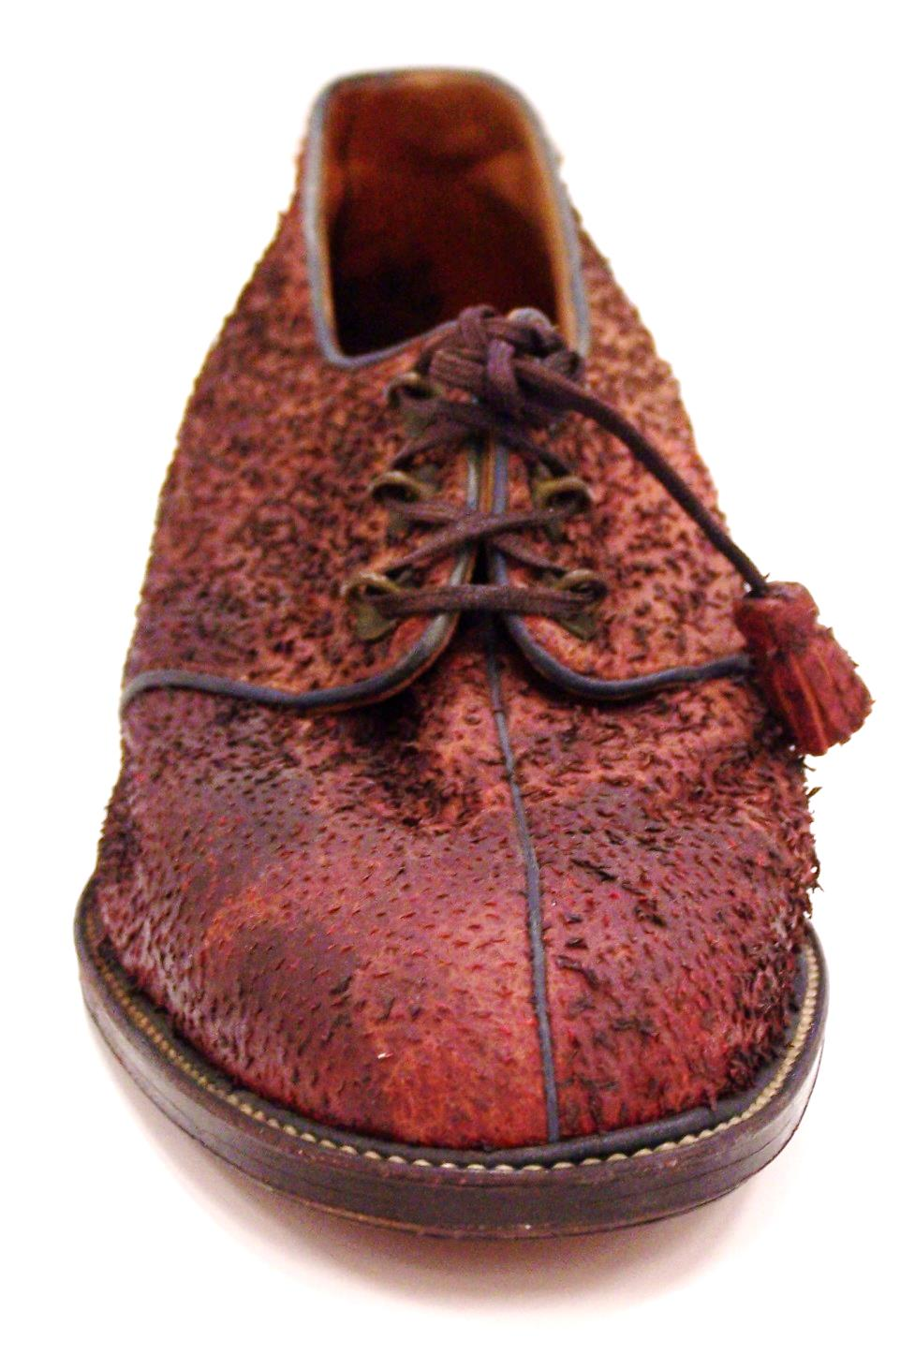
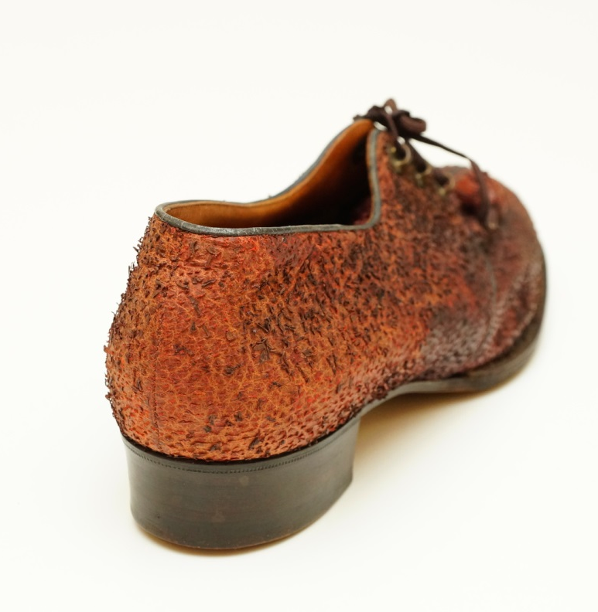
Photos: A. Kratky, VFU Brno

Slide 14
Photo: A: Kratky, VFU Brno

Slide 15
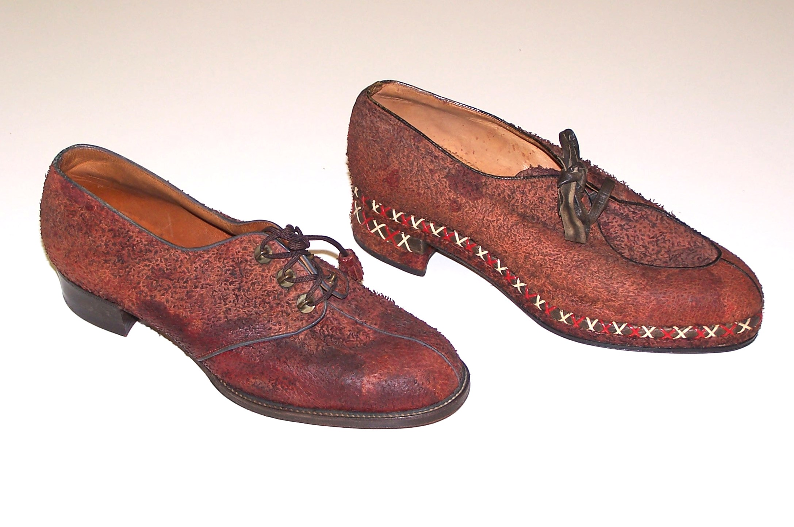

Slide 16
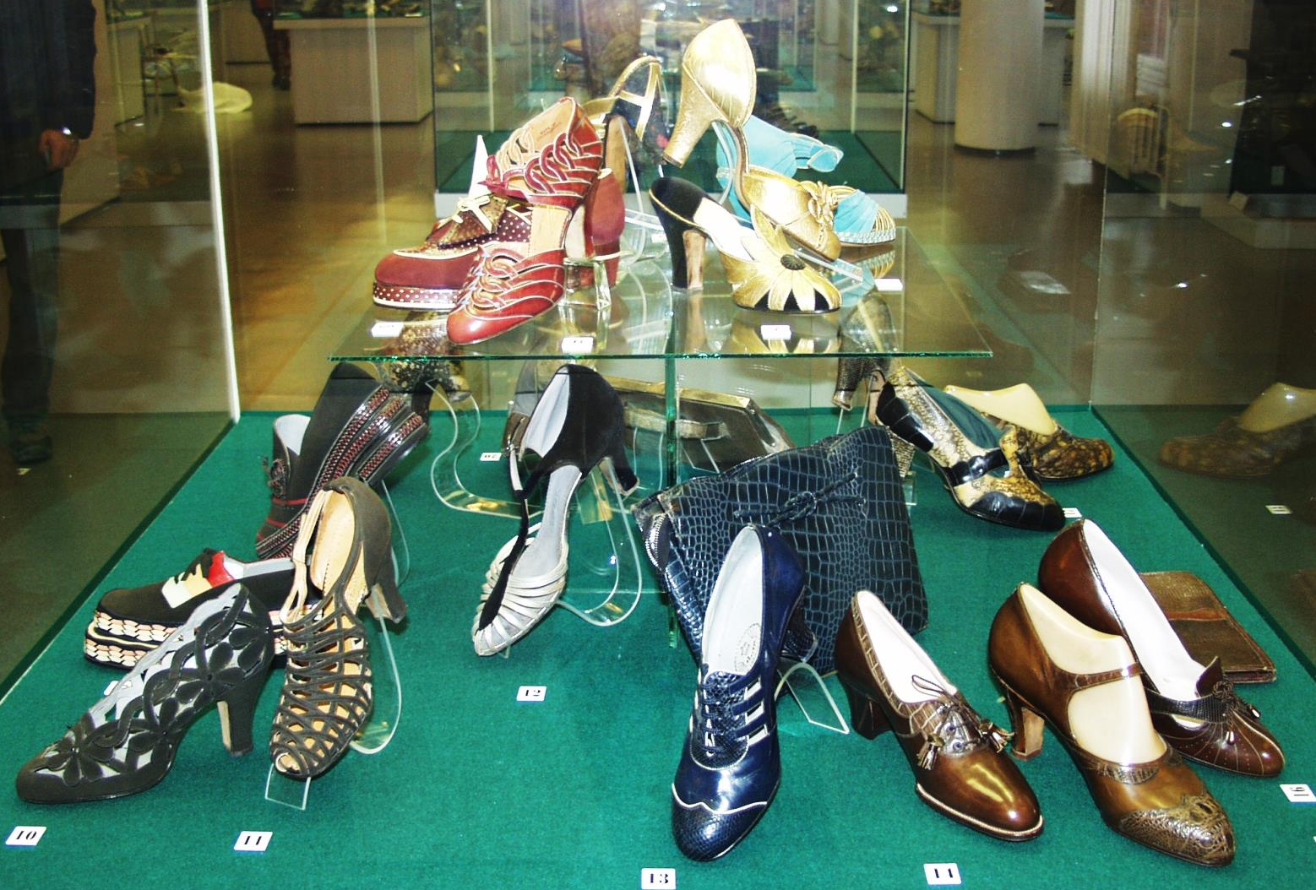
Collection of Bata shoes, including the New York collection;
2nd half of the 1930s
Museum of South-Eastern Moravia, Zlin, Czech Republic, 2004
Thank you.

