Slide 1
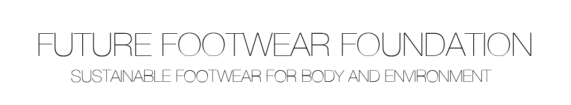
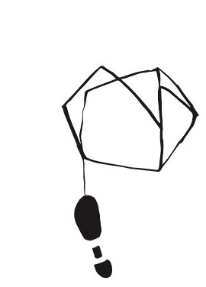
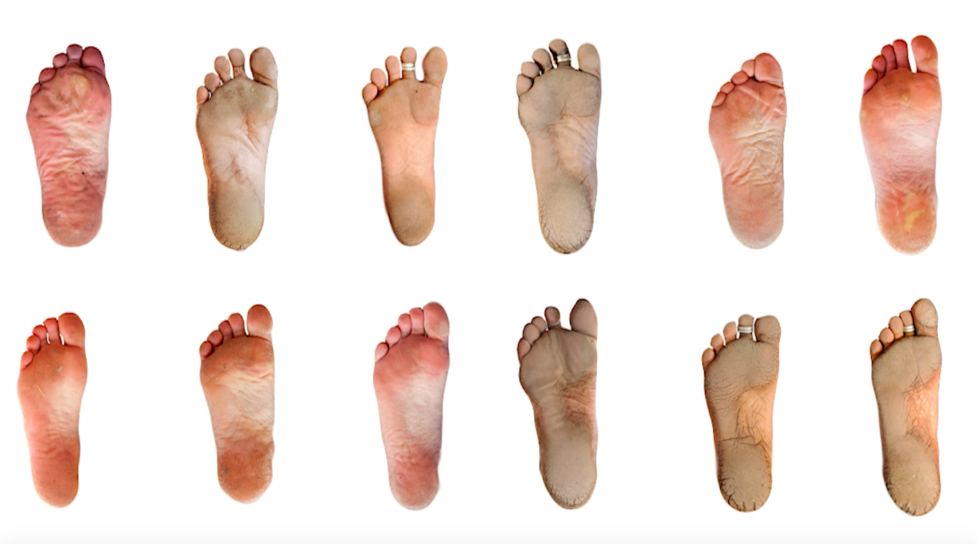
KASK SCHOOL OF ARTS HOGENT ● VIVOBAREFOOT ● MATERIALISE ● RSSCAN ● UNIVERSITY OF LIVERPOOL

Slide 2
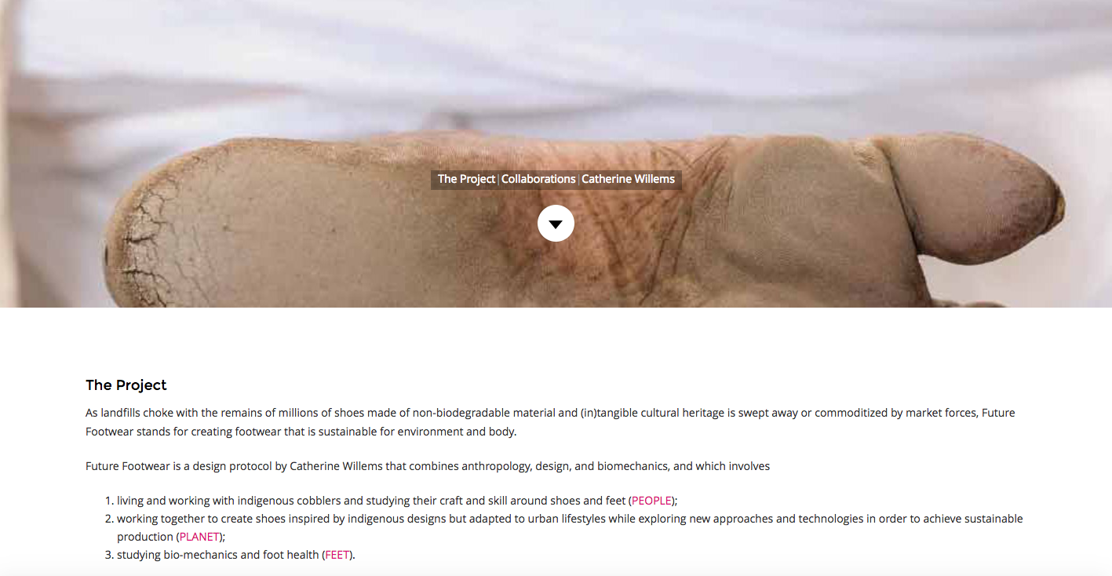

Slide 3
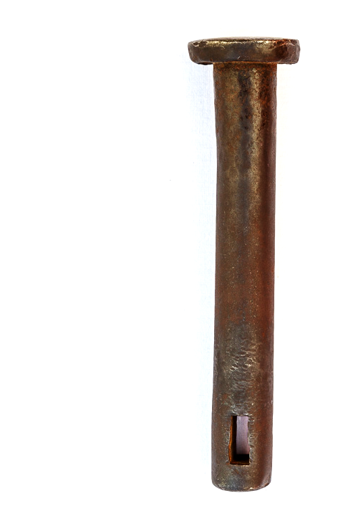
STRUCTURE
Evolution of walking
Sustainable footwear for body and environment
  Questions & Design frame
    People – the cases
    Planet – design anthropology
    Feet – biomechanics
  Main findings
Case - Ju’Hoansi of Nyae Nyae in Namibia
Addendum - Indigenous versus 3D

Slide 4
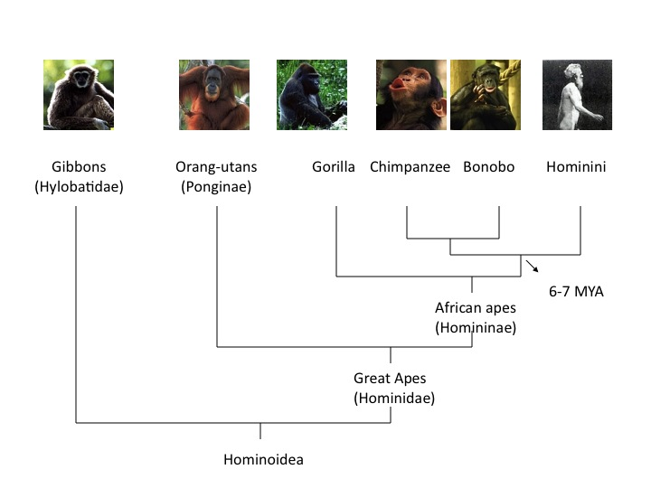

Slide 5
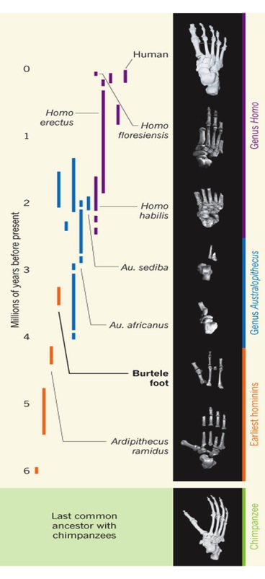
Lucy’s feet – Walking along the evolutionary line.
http://science.discovery.com/tv-shows/greatest-discoveries/videos/100-greatest-discoveries-laetoli-footprints.html australopithecus afarensis

Slide 6
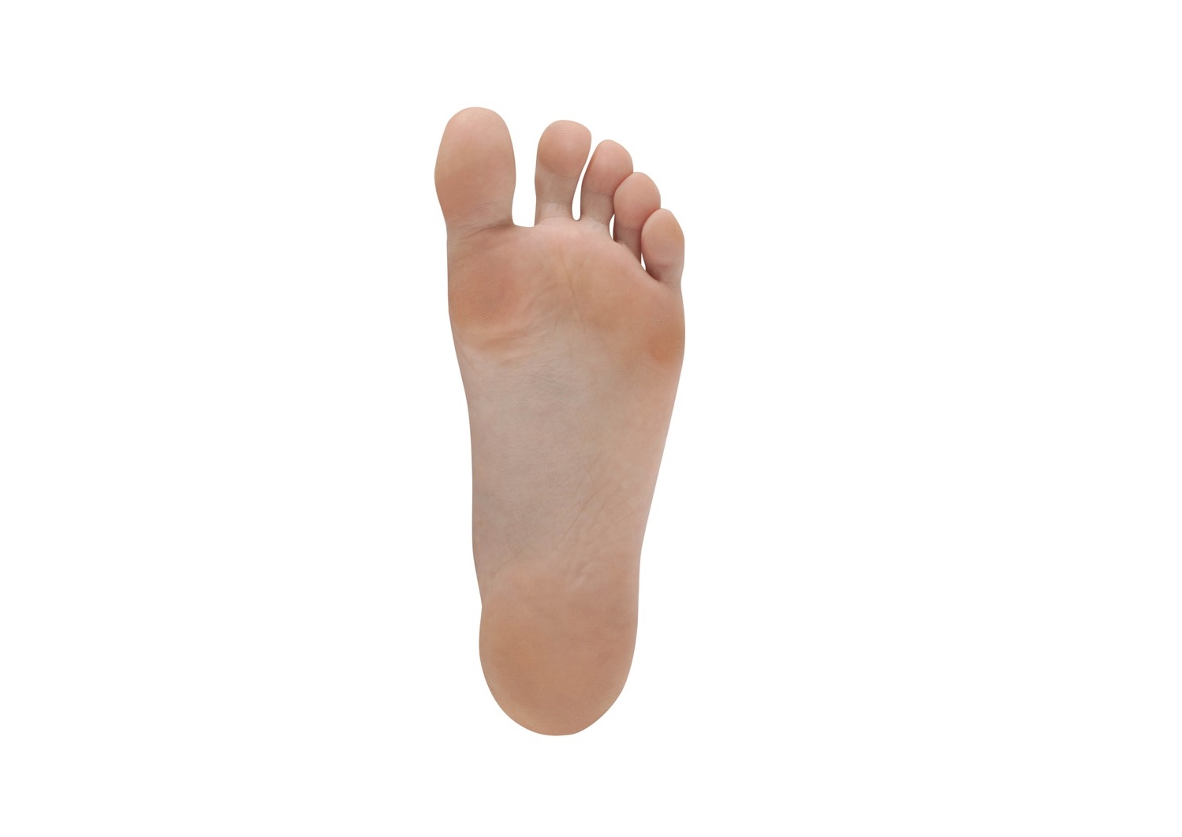

Slide 7
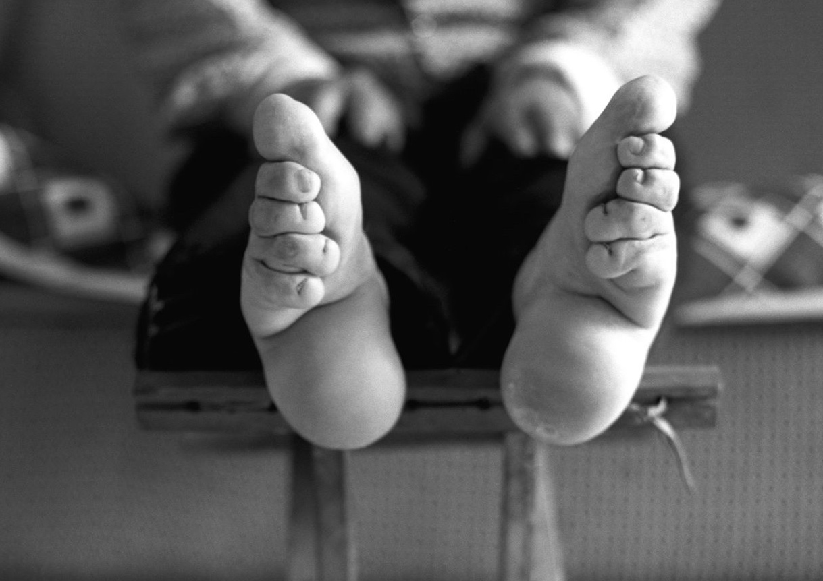

Slide 8
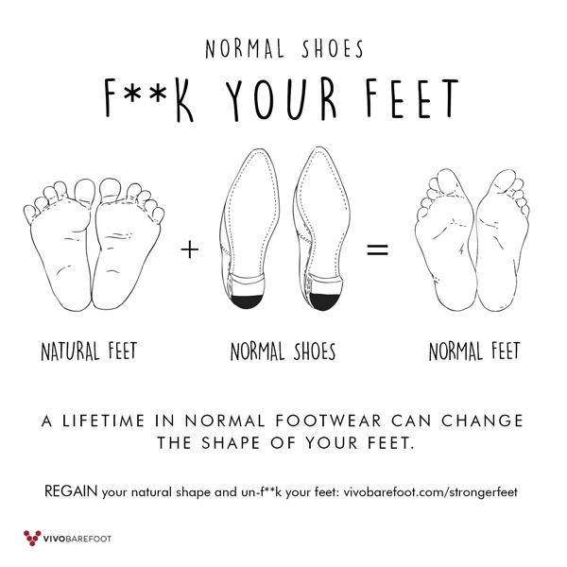

Slide 9
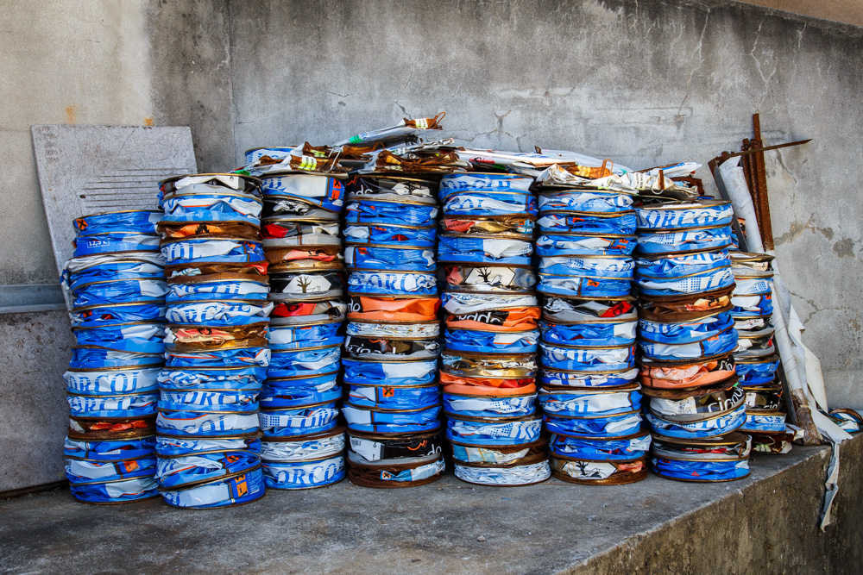
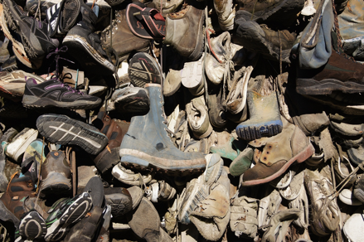
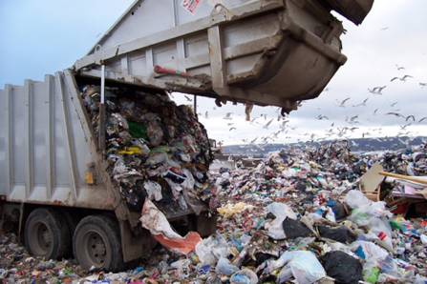

Slide 10
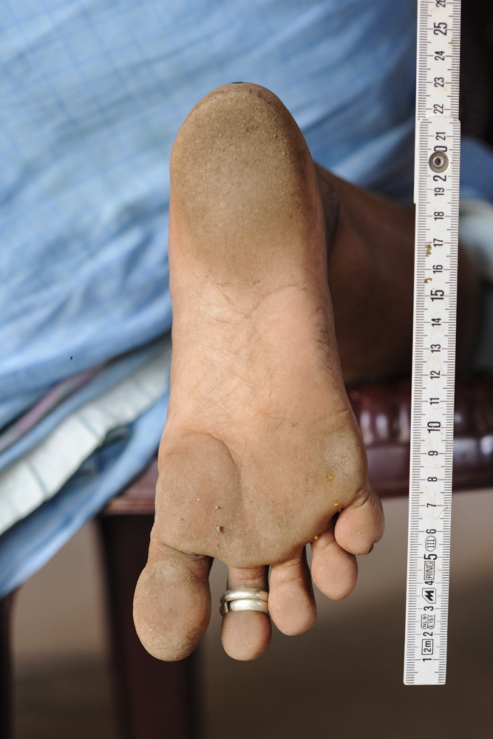
QUESTIONS
How can we design footwear that respects human natural anatomy and offers at the same time maximum protection?
How can we create footwear that does not degrade the source and sink functions of our environment and that keeps our natural capital intact?
Can the role of the ancient be more than just a form related inspiration in the design of new footwear?

Slide 11
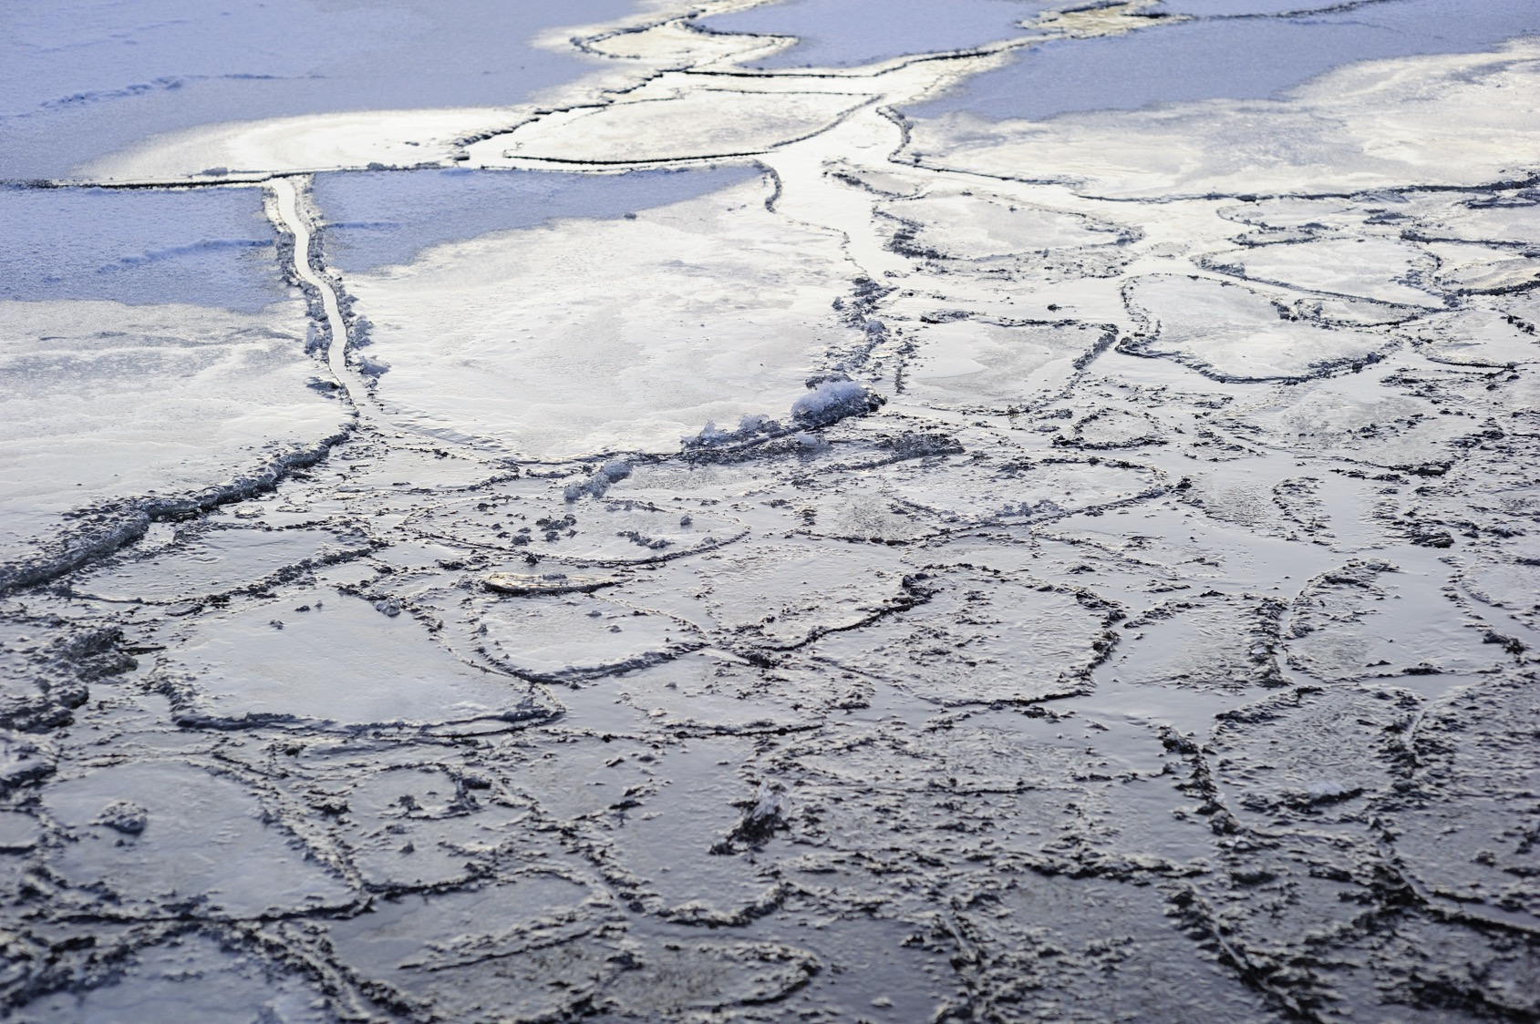
Notes:
the saami in the north of scandinavia use the fur leg of a reindeer to make the ligthtest and warmest winter boot ever
one reindeer is good for one pair of boots and ontly the legs are used for the boot but of course all the other parst of the animal have their own specific purpose
nothing is wasted

Slide 12
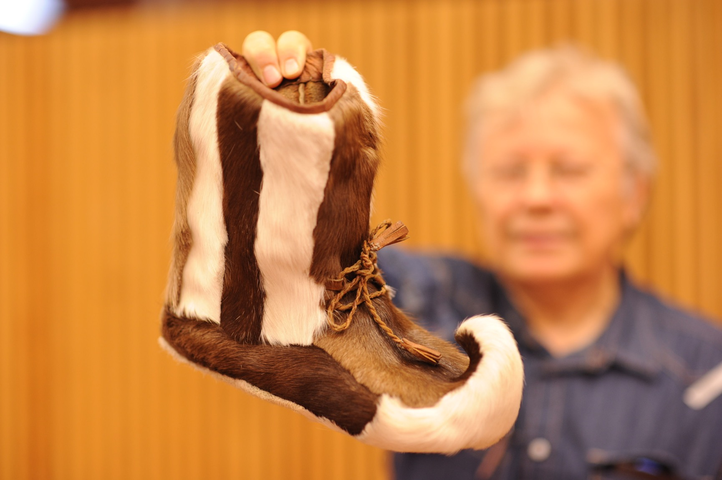

Slide 13
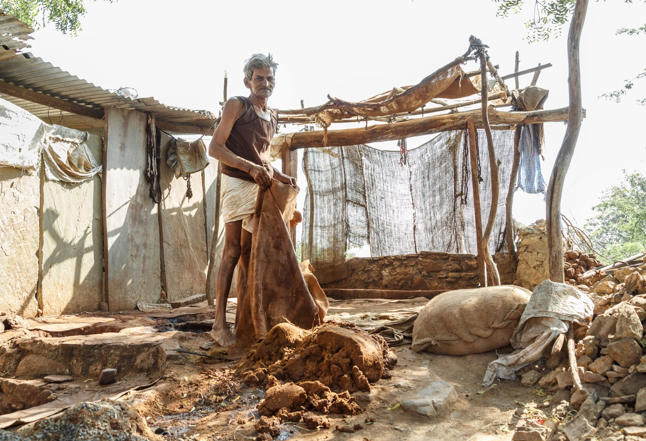
Notes:
next to the biomechanics
we work and live together with cobblers to create and re-creat their footwear for different environments and to enhance livehood opportunies
shoemakers are often at the lower end of the socieyt, like the chamar , the shoemking communities in india
the kolhapuri cobblers in india use bag tanned buffalo leather for their sandals

Slide 14
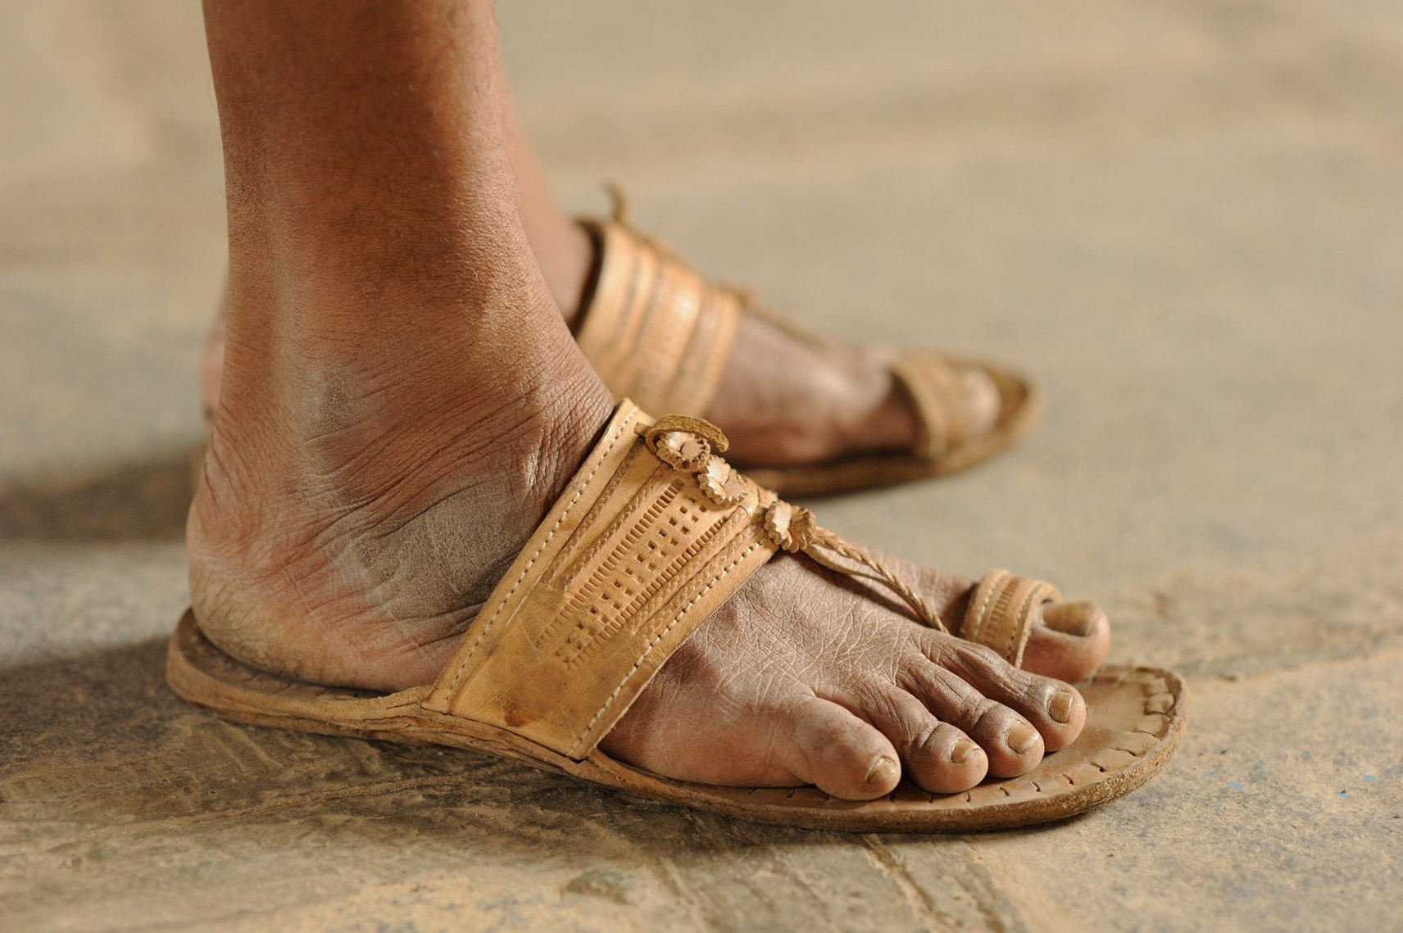
Notes:
one buffalo is good for 15 pairs of sandals
out and insole are sewn together with the thread coming from the tail of a biffalo
biomechanical reaseach revealed that this type of footwear can be consideren minimal footwear avant la lettre

Slide 15
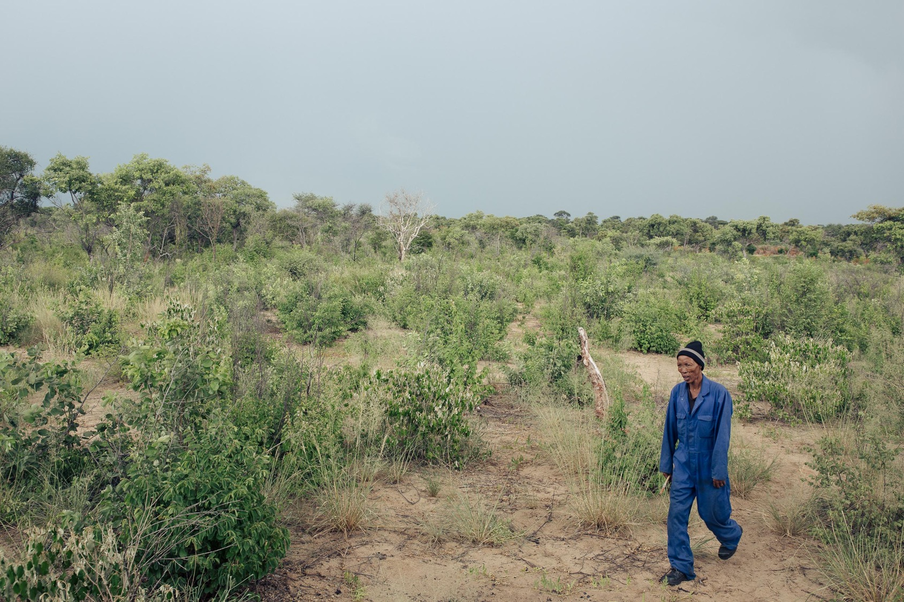
Notes:
the juIhoan san in the north namibia use vegetable tanned antilope skin to make their ancient hunting sandal
the ju hoan are one of the few communities on earth that still practice persistenve hunting which is the rare skill to outrun an animal until colapses of exhaustion
they do this on the hottest moment of the day when the sand is to hot to walk on barefoot and they protect their feet with and eland sandal

Slide 16
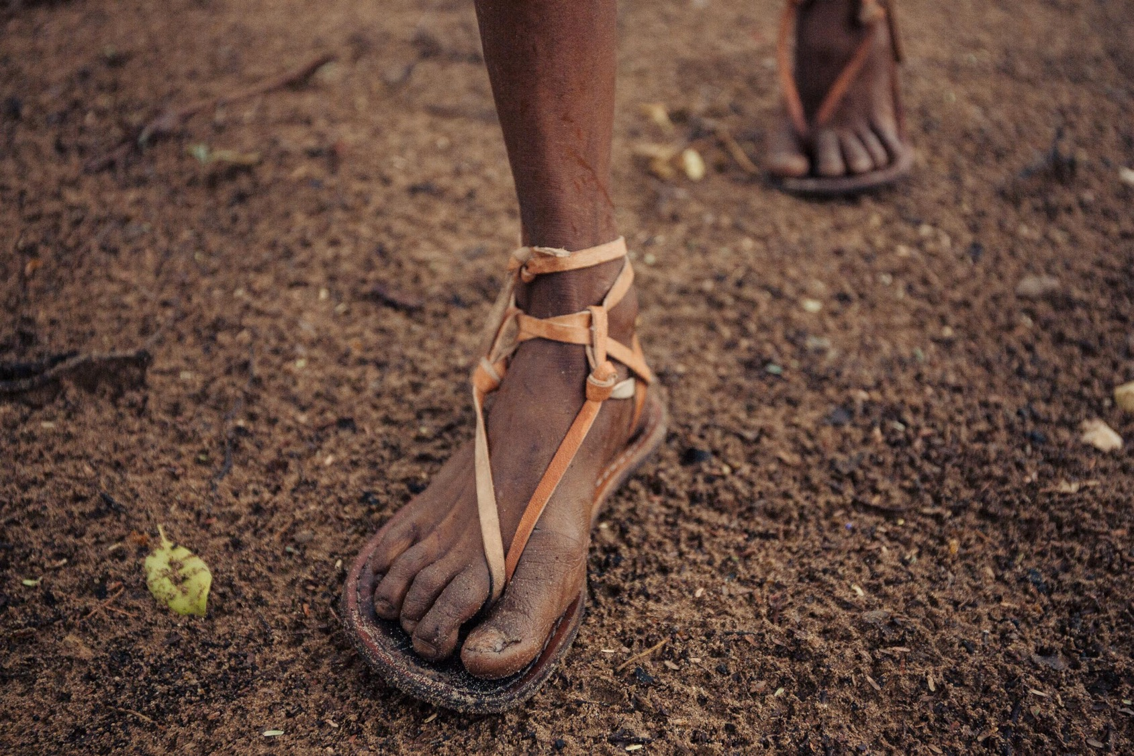
Notes:
used to a more immeditate return eceonomy
crowdfunding and making footwear for a specific person is more in line with their worldview

Slide 17
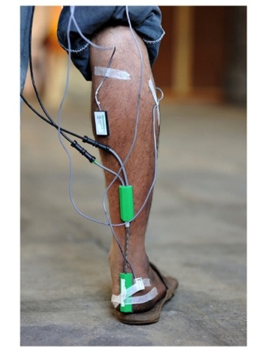
ure directions
FEET Walking on natural and artificial substrates: the effect of indigenous footwear.
sEMG
Impact and foot function
Goniometry
Shod
vs
Barefoot
Artificial substrate
vs
Natural substrate
Accelerometry

Slide 18
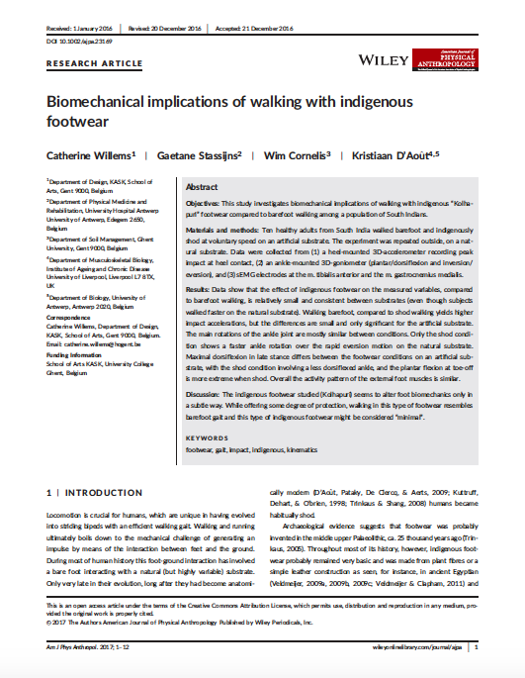
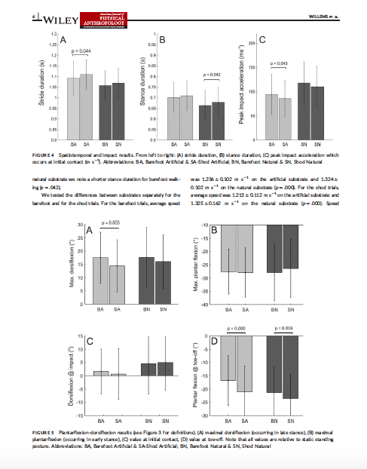

Slide 19
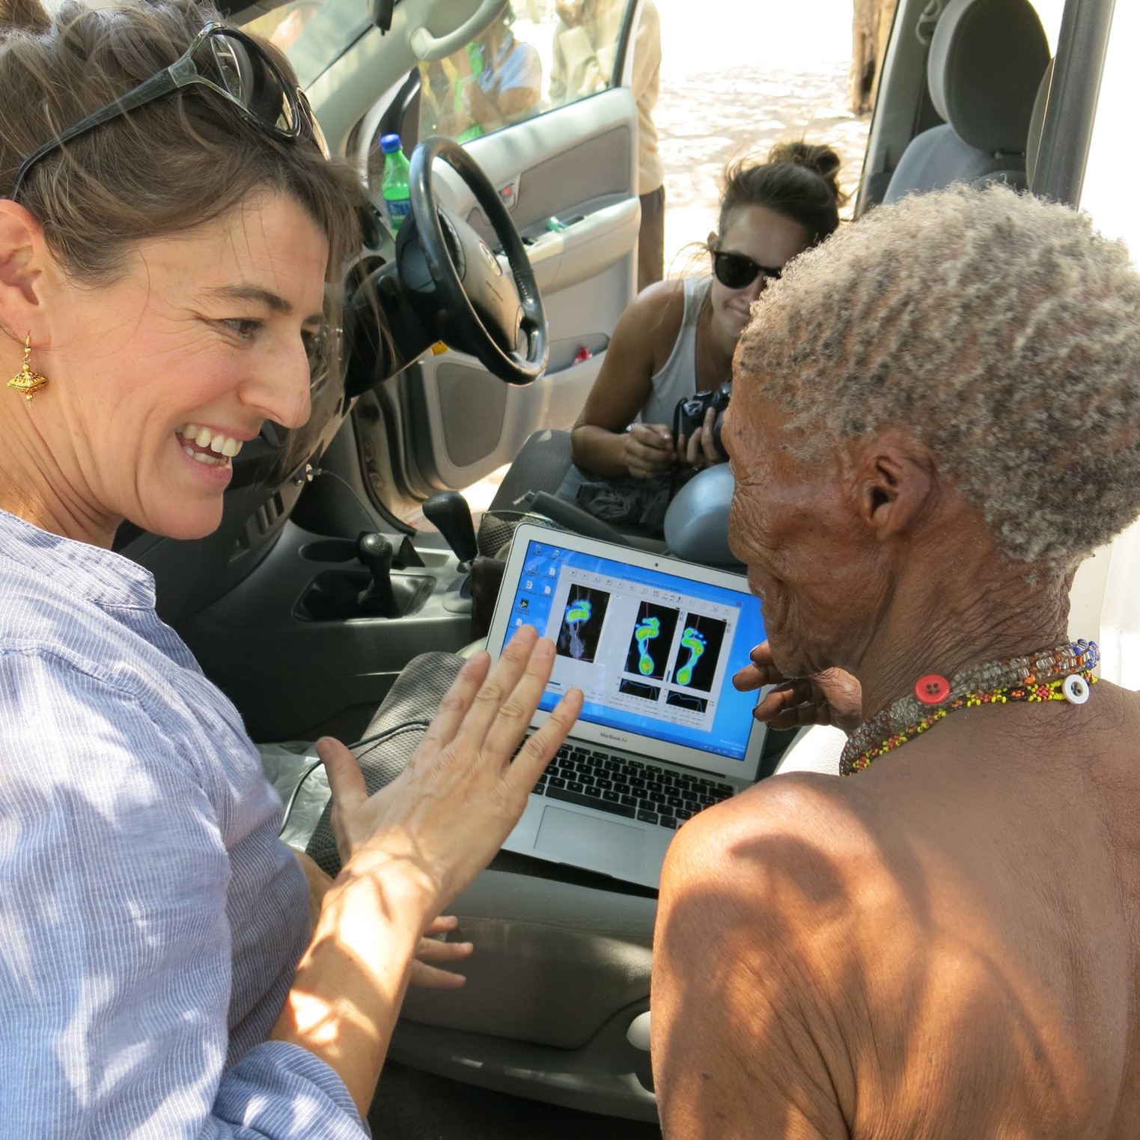
Notes:
we compared barefoot walking with shod walking and focused on the dynamics of walking using a datalog system and a plantar pressure plate. the
The portable labo moved from India, to Finland, to London, to Namibia and was placed yesterday at the museu do oriente where some of you took a walk

Slide 20
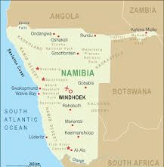
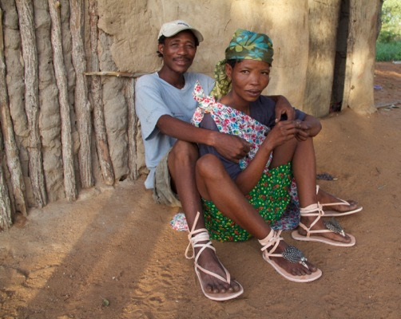
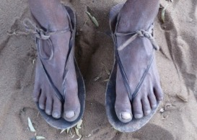
PEOPLE Ju’Hoansi, people of the Kalahari, Namibia.
Notes:
Het antropologisch en design luik toon ik aan de hand van de case bij de Ju hoansi
The mission of the project is to bring back their tradtional hunting sandal, to stimulate natural gait, and to enhance self-reliance
As hunter gatherers and one of the last persistence hunters on this planet their traditional economy was based on food sharing and social equality. But this traditional economic model does not sustain them any longer. Many practices were lost while others gained new meaning as an alternative way of income in the transition to modernity. Since the ’70 the Ju’Hoansi settled mostly in permanent villages with a mixed economy composed of foraging, income from wage labour, government aid, animal husbandry, pensions, and crafts

Slide 21
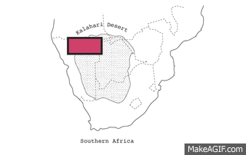
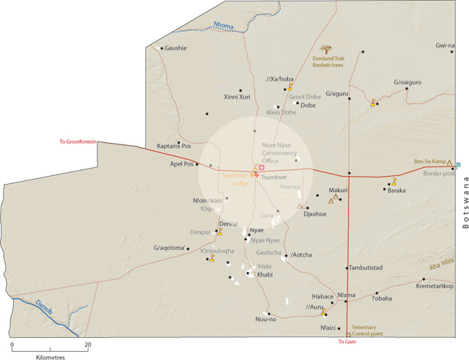
PLANET Ju’Hoansi, people of the Kalahari, Namibia.
Notes:
A kickstarter campaign was launched in May 2016
On June 2016 ca 600 backers gathered 92000£ to bring the project to live.
-binnen Het gebied van Antropologie situeer ik het project in de subdiscipline van Design Antropologie. De methode van onderzoek is actie onderzoek en dat vertaalt zich in het samen maken met de artisans, met de schoenmalers. Dit type onderzoek is dus niet louter beschrijvend. Ik zit niet zoals antropologen vaak doen, in een hoekje met een boekje. Studie van de mens, studie van de makende mens

Slide 22
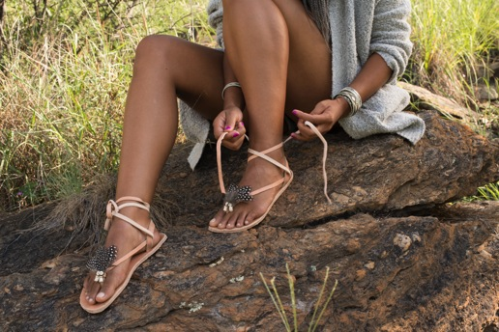
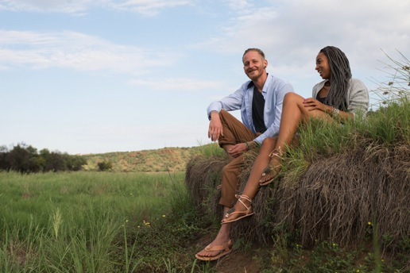
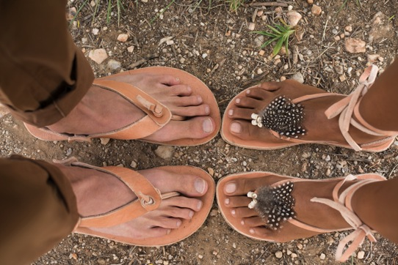
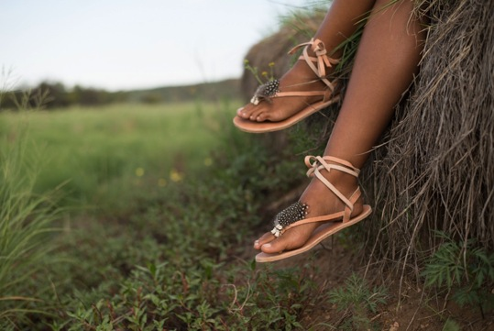

Slide 23
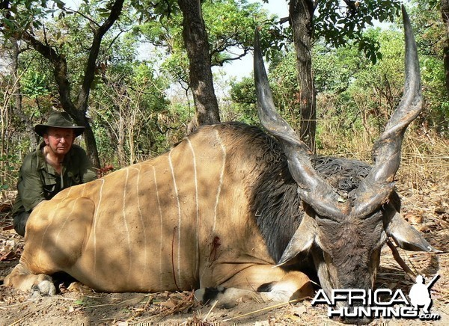

Slide 24
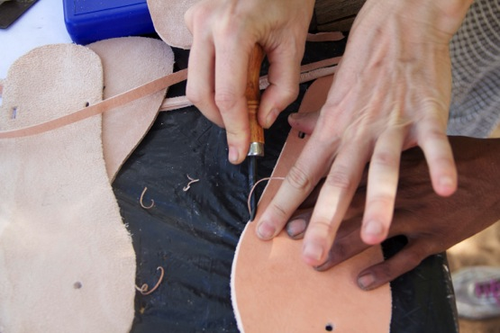
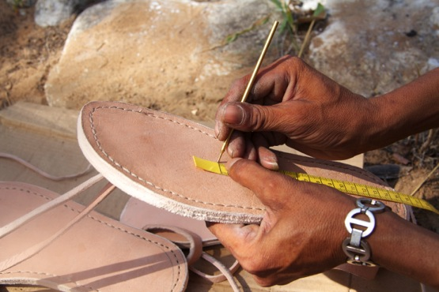
PEOPLE Ju’Hoansi, training, Namibia.
Notes:
Aside the adjustments in design there were other market conformity aspects, which had to be met when targeting the international market.
Traditionally the Ju|’hoansi do not work on large orders which are frequent in the international market. As a consequence capacity issues and difficulties to finish the orders in a specific time frame occurred. The size of the orders was in contrast with the immediate return economy where the Ju|’hoansi society a hunter gatherer society is built upon. This led to major problems. In 2016, after the Kickstarter Campaign, 1140 pairs of sandals were ordered. The estimated delivery time was October 2016. However, one year later only 570 (50%) of the san-dals were delivered
An order of san-dals e.g. larger than twenty pairs led to capacity issues. The cobblers did not receive an immediate return for their work as the time between production and payments was irregular and often started other jobs or went hunting

Slide 25
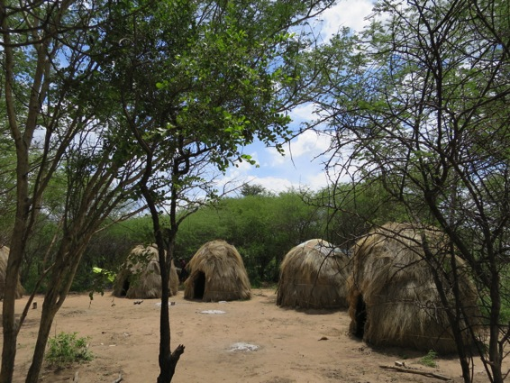
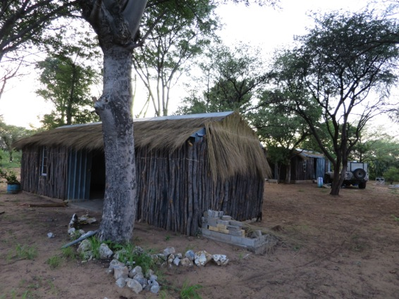
PEOPLE Ju’Hoansi, atelier, Namibia.
Notes:
In hunter gathering community Profits are not only translated into monetary terms but also in social interaction. The ‘hxaro’ gift is an exchange to consolidate ties or trade with other communities. Jewels made of ostrich shells or glass beads can be an example of this hxaro gift (De Voogt & Ying Ng, 2017). Focussing on western market-based models with monetary profit can be seen as an opening to promote capitalistic western frames or as a sneaky way to search new market opportunities.

Slide 26
Notes:
FOTO BEEMATASI

Slide 27
Notes:
PLAN BRUNO

Slide 28
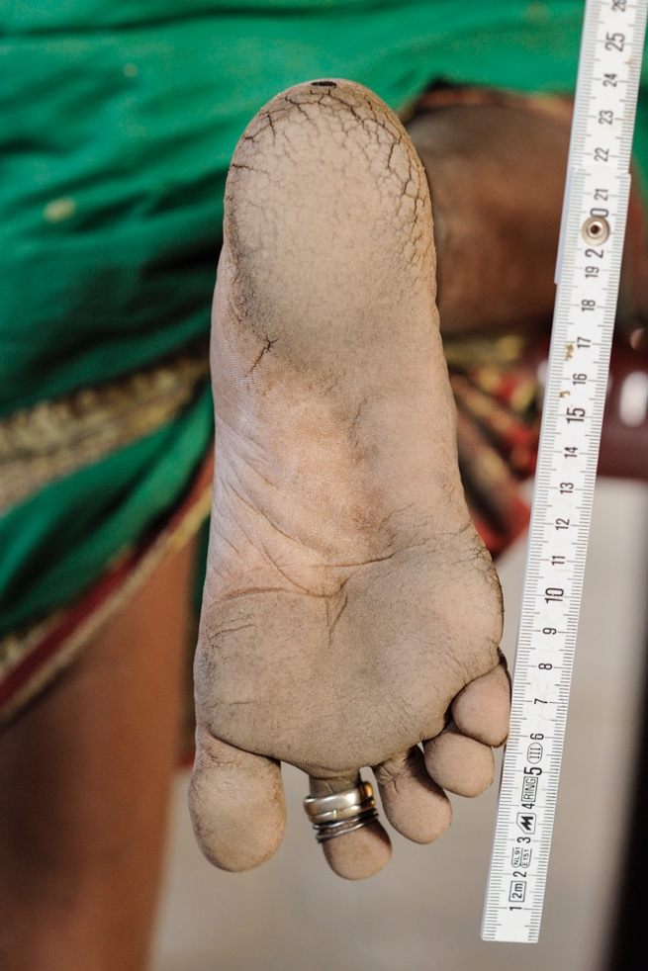
MAIN FINDINGS
Looking into indigenous footwear and combining insights from the different disciplines can guide design for minimal footwear:
The footwear under research is similar to barefoot walking;
The local handmade footwear is sustainable for the environment;
The new 3D printing with laser sintering is closest to the indigenous production in amount of waste generated and the tools and manpower needed.
Notes:
The main findings are that looking into indigenous footwear and combining different insights from the different disciplines can GUIDE design for sustainable footwear
Because of the following reasons
-

Slide 29
Guidelines barefoot design
CATEGORIES | FEATURES
1. Performance | High proprioception
 | Made to measure
 | Anti slip
2. Materials | Non-toxic
 | Light weight
 | Breathable
3. Production | Low piece design
 | Low amount of materials / minimum waste
 | Handmade slow production
4. Durability | Material Longevity
 | Emotional durability
 | Repairability
5. After Life | Easy to disassemble
 | Down-, re- or up-cycle
 | Bio degradable
Notes:
The following features were extracted from the indigenous cases and grouped over different categories: performance, material, production, durability and after life

Slide 30
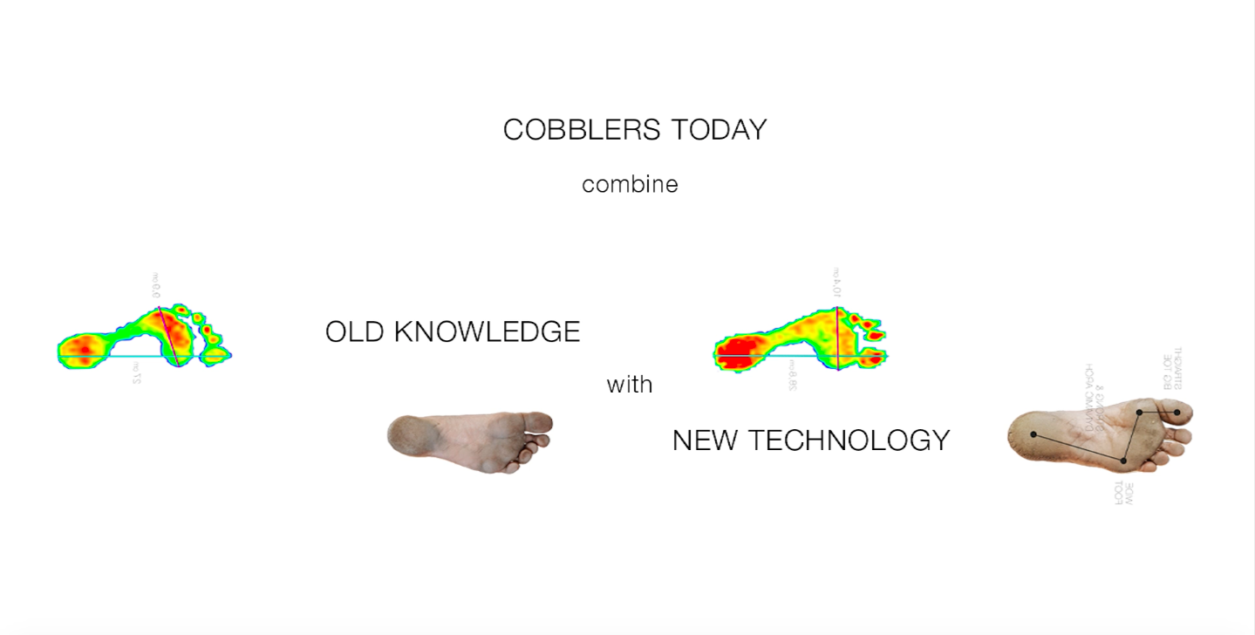

Slide 31
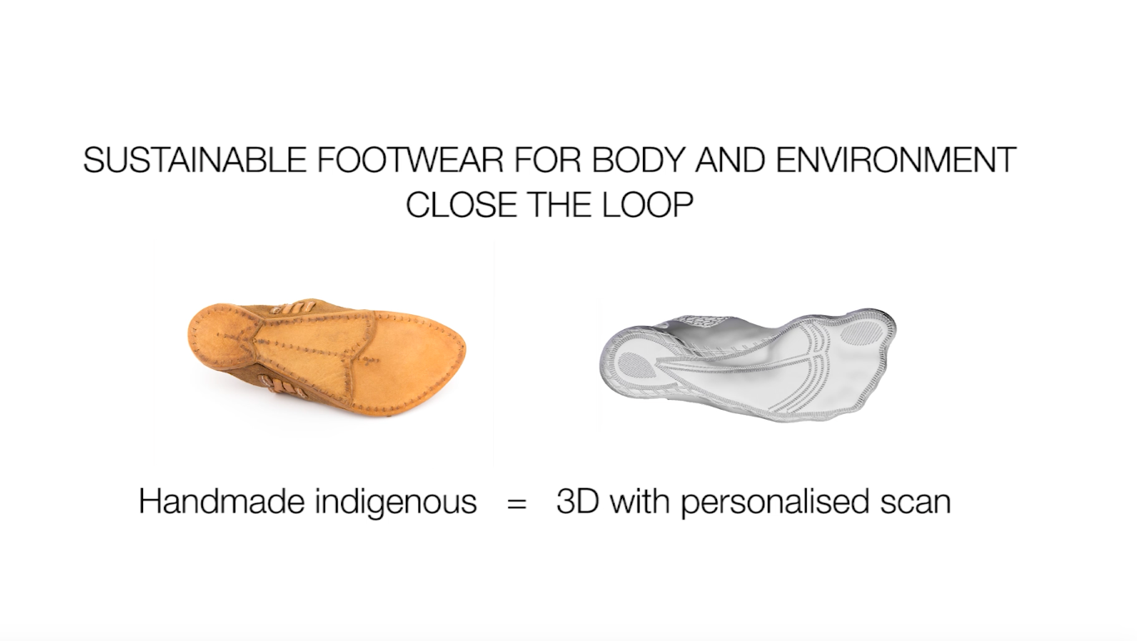

Slide 32
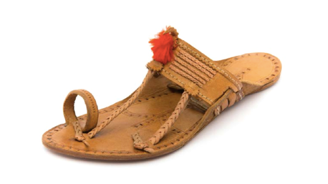
X-Indigenous by Toehold Artisans (India)
Notes:
During the design collaboration with the toehold artisans we kept the main feature of the shoe, being:
Low piece design
One material
No glues
No arch support
No cushioning
BUT we added a barefoot last to make the handmade production. This production will be on the market for Summer season 2017 and is fully handmade by Toehold artisans collaborative situated in Ahtni, maharastra india

Slide 34
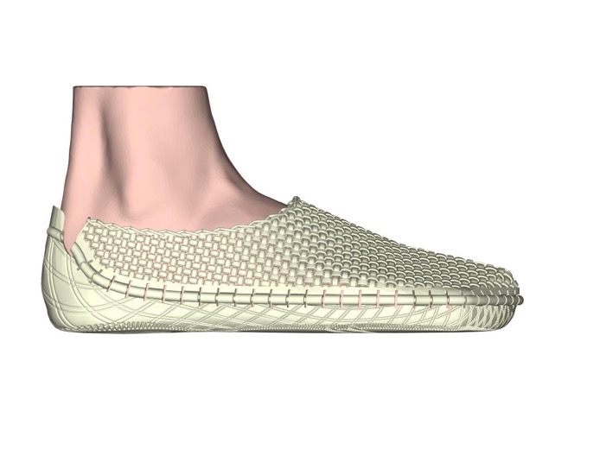
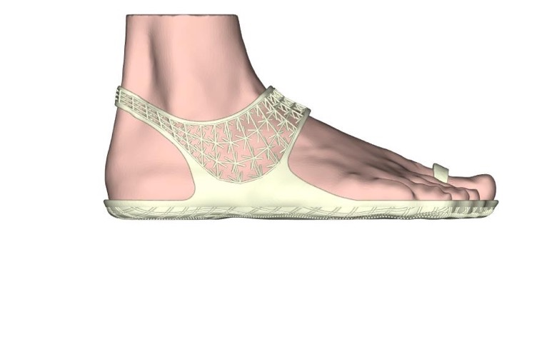

Slide 35
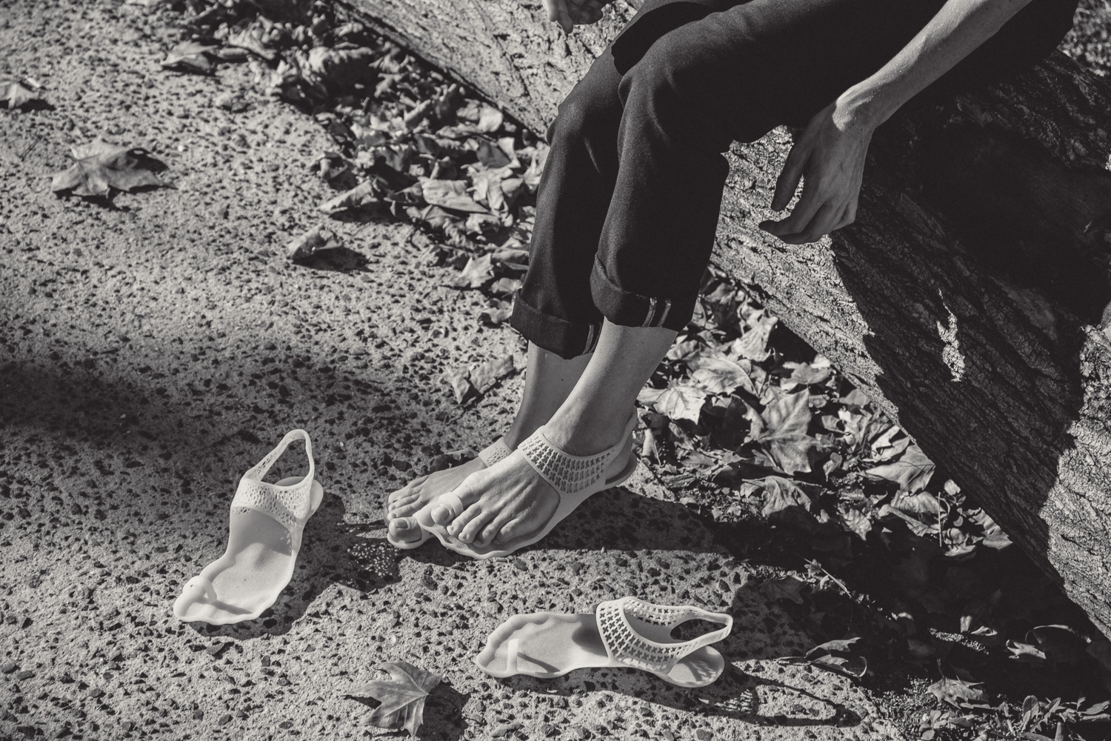

Slide 36
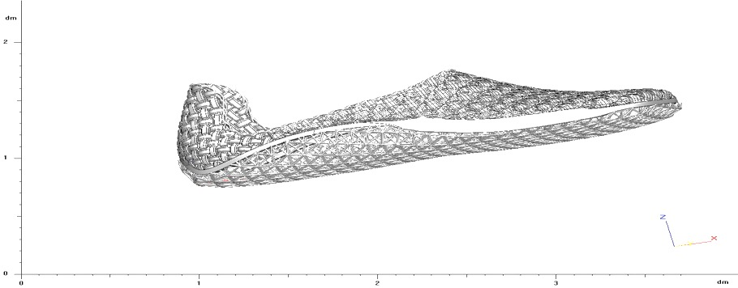
3-D Selective Laser Sintering Print (Rsprint, Materialise, Belgium)
Notes:
All design experiments focus on design for reuse, disassembly, material recovery, and product lifetime. In the ‘3D-Print’ project, the footwear is created using Selective Laser Sintering technique. 3D printing is an additive process. Which means that the material is not cut from larger pieces and then reassembled to manufacture the final object but added in just the right amounts to create an object.
This software directs powder in a printer to build up a physical product layer by layer creating a fully formed object. This thechnique uses one tenth of the material used in conventional manufacturing (Rifkin, 2014). “Future Footwear 2.0” my current research project focuses on customized footwear using new devices to scan feet in 3D in combination with plantar pressure scnas and combines this with the software to 3D print footwear. The re-creation of indigenous footwear into 3D models is done in collaboration with RS Print a joint venture of materialise and rsscan. The personalised footwear will come on the marktet early 2018.

Slide 37
THE FUTURE OF FUTURE FOOTWEAR
Collecting more data of barefoot and minimally shod populations;
Bringing back the knowledge to the participants of the communities;
Co-create footwear that is sustainable in the long term and provides a stable livelihood to the artisans;
Focus on customized footwear using new devices to scan feet in 3D;
Translate indigenous skills and material features into ‘3D printed footwear’;
Translate ‘barefoot’ gait into contemporary ‘minimal’ footwear design using plantar pressure data
Notes:
The quest for solutions that are sustainable in view of net waste production and energy use is increasingly urgent. This includes environmentally positive supply chains and logistics as well as design for reuse, disassembly, material recovery, and other extensions of material and product lifetimes. Indigenous knowledge and craftsmanship can guide us in finding sustainable solutions for footwear production. In this quest we must avoid the ‘hit and run’ strategy of gathering knowledge as an outsider in the community and using it for academic or economic purposes without the involvement of the community and without paying attention to its views, needs, and interests. A focus on craft related skills of indigenous groups and on a decentralized production can enhance the economic wellbeing of remote communities (Hitchcock and Spagnoli, 2016) and offer alternatives to the international ‘fashion and design’ powerhouses.
MOET HIER NIET IETS OVER 3D KOMEN?????
but equally important are the collections with the indigenous groups that will come on the market through crowd sourcing

Slide 38
The ultimate goal is to make the healthiest shoes in the world – for the individual and for society.
By combining ancient wisdom
with new technologies.
www.futurefootwearfoundation.com
www.instagram.com/futurefootwearfoundation
www.facebook.com/futurefootwearfoundation

Slide 39
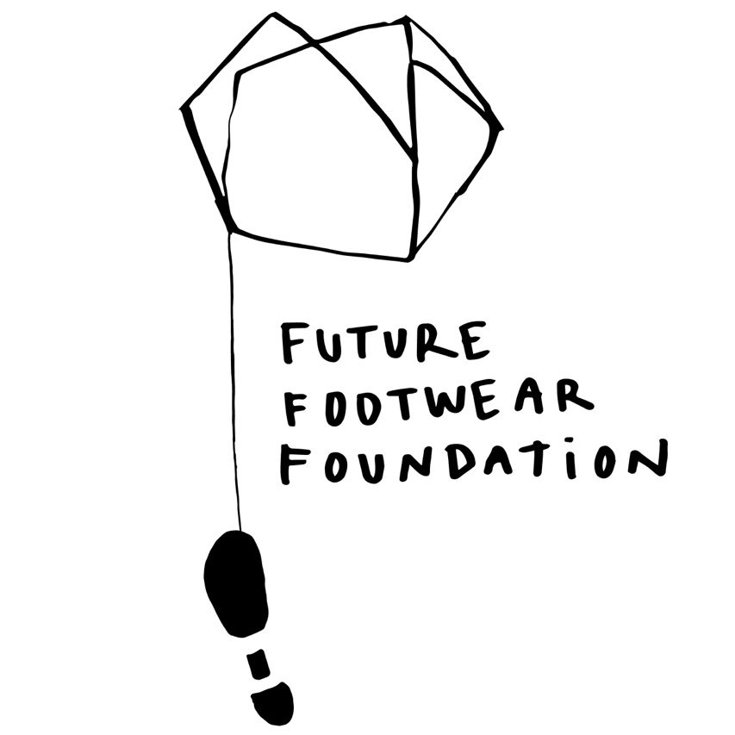
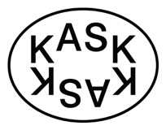

Future Footwear Foundation at KASK School of Arts, Hogent, Gent,
in collaboration with RsScan, Materialise and VIVOBAREFOOT.

Slide 40
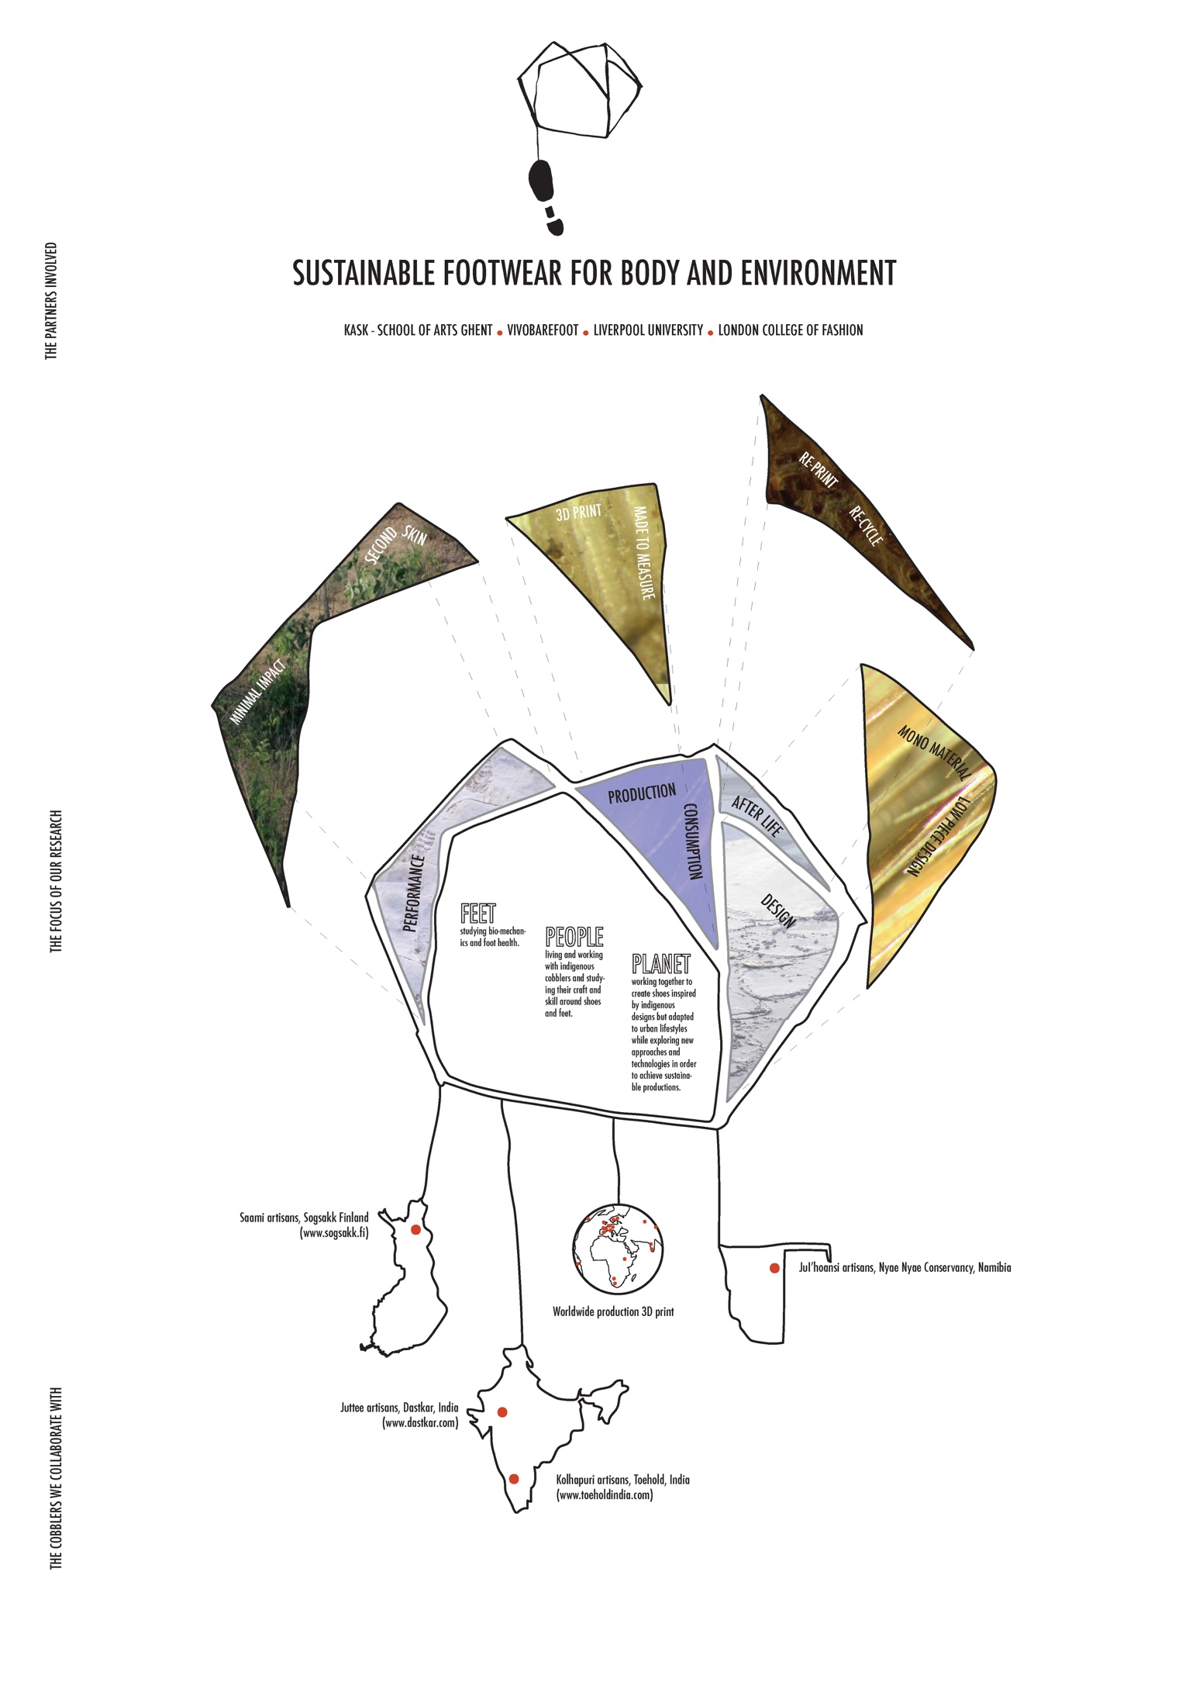
Notes:
Future footwear foundation is a research center that aims to get multidisciplinary insights into footwear, we use different ways of analysing footwear and gait.
I start with in-depth interviews with the artisans on their gait and health. Next comes the biomechanical measurements and the action research and apprenticeship with the artisans.
To gather the information cases of indigenous footwear were selected
. A case of contemporary footwear—‘Vivobarefoot’ (London, United Kingdom)—was added to enable comparisons of biomechanical performance and indigenous and contemporary ways of producing.
In the design research I follow a sociocultural approach with an emphasis on context and on process over object. The main focus is not on the form and not on novelty in the sense of stimulating innovation. I am more interested in looking at how things are created and how we can use these insights. The focus is not on Western design but goes beyond. I see design as the convergence of form and matter, which I view as equally important in the shaping of objects. That is why I put so much emphasis on the materials, in my study mainly vegetable tanned hides. And that is also why I included the physical tests on the hides. also to guide research on new filament, non oil based filaments for 3D printing and on new structures in 3D to enhance breathebality. .
-From an academic perspective I situate the project in the subdiscipline of Design Anthropology.
Antrhopology is the study of people
Dsign anthropo studies how people create, and make
I follow a practice based method of learning with the artisans. This is mainly a non-linguistic form of knowledge gathering. While making the footwear I look at which tools are used, how the tools and hands transform the material, and at the same time I take notice of the connected production process. This type of research is mainly transformational and goes beyond documenting. Design and making are analysed from an internal position, in between the materials and together with the artisans. In this I follow the in-habitat approach of professor Ingold, as explained in his book the perception of the environment and making.

